Slide 1
Early International Nuclear Controls
Part 1: Acheson-Lilienthal Report, Baruch Plan, and Atoms for Peace
A presentation by
Henry Sokolski
Executive Director
Nonproliferation Policy Education Center
www.npolicy.org
© Nonproliferation Policy Education Center

Slide 2
Question 1:
Why bother with older nuclear control initiatives?

Slide 3
Answer 1:
Older nuclear control initiatives integrated control of civil and military nuclear energy. We are rediscovering nuclear restraint requires controlling both
(e.g., China's "peaceful" plutonium, tritium,
and uranium production).

Slide 4
Question 2:
What did the authors of the earliest initiatives—the Acheson- Lilienthal Report, Baruch Plan, and Eisenhower’s Atoms for Peace Program—see as the next nuclear war scenario that needed to be avoided?

Slide 5
Answer 2:
Baruch Plan feared with relative few atomic weapons, nuclear aggressors could always win by targeting cities; there’d be no defense. Atoms for Peace feared U.S. military mobilization base could be knocked out with large stockpiles consisting of 100s to 10,000s of nuclear weapons.

Slide 6
Question 3:
How did their nuclear threat perceptions shape their views of which nuclear activities and materials were safe or dangerous and how these should be controlled?

Slide 7
Answer 3:
The Baruch Plan placed tight controls on almost all nuclear activities and materials. Controls under Atoms for Peace were more relaxed as the U.S. was primarily concerned about preventing large military diversions – hundreds of bombs’ worth or more.

Slide 8
Question 4:
How sound were their nuclear threat perceptions and their policy prescriptions to avoid the worst?

Slide 9
Answer 4:
The Baruch Plan mistakenly downplayed deterrence and defenses and focused too much on the targeting of cities. This encouraged tight controls but also intense fear and distrust of the Soviets, which made agreeing to any controls impractical.
Atoms for Peace ignored how few nuclear weapons it would take to knock out U.S. SAC bases or to catalyze major nuclear wars. As a result, it paid too little attention to preventing smaller military diversions consisting of a relative few nuclear weapons worth of material.

Slide 10
I. What did the earliest Strategic control initiatives see as the nuclear war threats to be controlled?

Slide 11
ACHESON Lilienthal Report and the baruch Plan

Slide 12
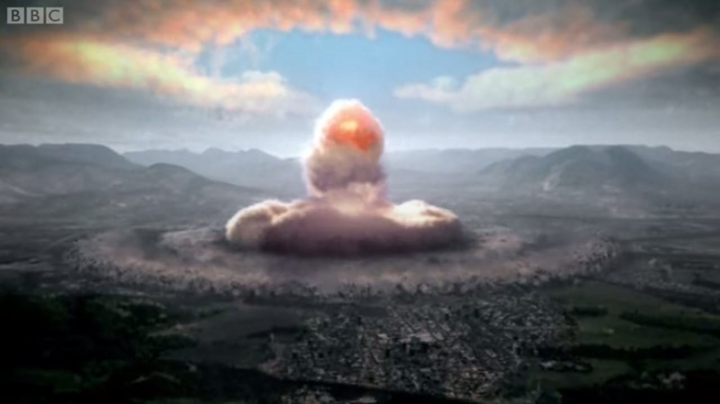
After Hiroshima: We feared Next Nuclear War would be the same
Whoever strikes first wins
No defense, the bomber (or missile) would always get through
Cities are the main target

Slide 13


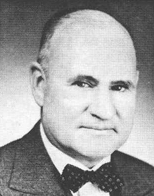




World was likened to Two Machine Gunners in a small room
A nation or even a political group, given the opportunity to start aggression by a sudden use of nuclear destruction devices will be able to unleash a 'blitzkrieg' infinitely more terrifying than that of 1939–40. A sudden blow of this kind might literally wipe out even the largest nation—or at least all of its production centers—and decide the issue on the first day of the war. If two people are in a room of 100 by 100 feet and have no weapons except their bare fists, the attacker has only a slight advantage over his opponent. But if each of them has a machine gun in his hand the attacker is sure to be victorious…with the production of nuclear bombs...the world situation approaches that of two men with machine guns in a 100 by 100 foot room.
Zay Jefferies, et al., “Prospectus on Nucleonics (The Jeffries Report),” reprinted in Alice Kimball Smith, A Peril and a Hope, pp. 539-559.

Slide 14
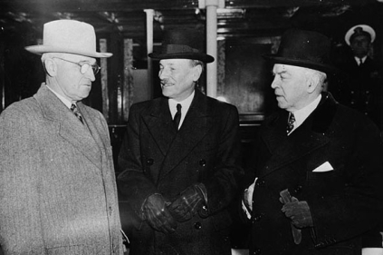
Harry Truman, clement Attlee, and mckenzie king endorsed this view 11/15/1945
Statement emphasized that there was no defense against nuclear weapons and that the salvation of civilization required the international control of nuclear energy so that the useful civilian applications could be shared without risk of military diversion

Slide 15
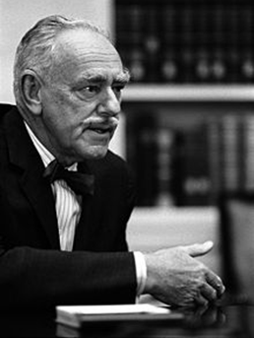
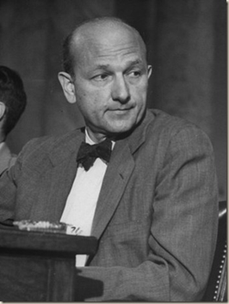
Dean Acheson
David E. Lilienthal
Undersecretary of State
Chairman Tennessee Valley Authority

Slide 16

J. Robert Oppenheimer: key author, acheson-lilienthal report

Slide 17
Acheson-Lilienthal premises Mirrored those of Scientists Movement
Atomic weapons were revolutionary “particularly as weapons of strategic bombardment aimed at the destruction of enemy cities and the eradication of their populations”
“There can be no adequate military defense against atomic weapons”
The uncontrolled development of nuclear energy “would not only intensify the ferocity of warfare, but might directly contribute to the outbreak of war.”
Only international ownership of dangerous nuclear facilities and materials with controls over all nuclear activities, and intrusive inspections to assure the Soviets did not have or was getting the bomb followed by U.S. nuclear disarmament could avert the annihilation of civilization

Slide 18
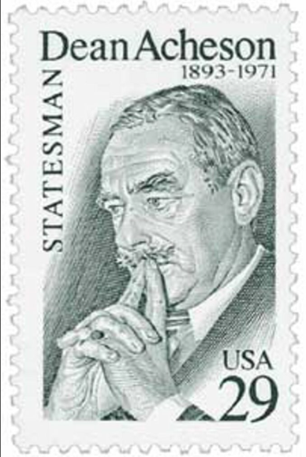
Acheson-Lilienthal Report’s key concepts were radical
There’s a distinction between “safe” and “dangerous” nuclear activities.
Uranium and plutonium can be denatured– rendered useless to make bombs.
Inspections alone are insufficient to prevent military diversions.
Timely warning is essential to prevent such diversions.
Economic market signals should be relied on to pace nuclear power development.
The geographic dispersion of dangerous nuclear facilities could be relied upon to deter “atomic war.”

Slide 19
Concept 1: There’s a distinction between “safe” and “dangerous” nuclear activities
“In our view, any activity is dangerous which offers a solution either in the actual fact of its physical installation, or by subtle alterations thereof, to one of the three major problems of making atomic weapons:
The provision of raw materials,
The production in suitable quality and quantity of the fissionable materials plutonium and U 235, and
The use of these materials for the making of atomic weapons”

Slide 20
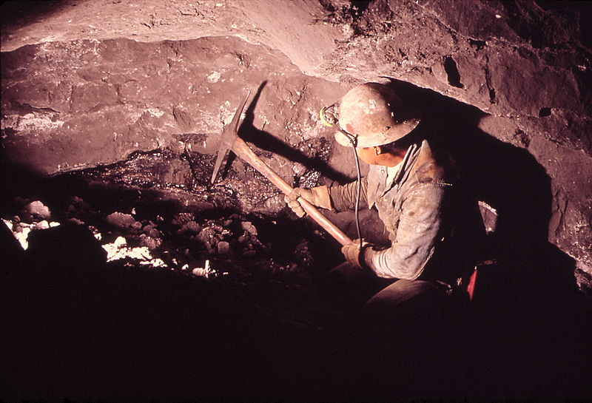
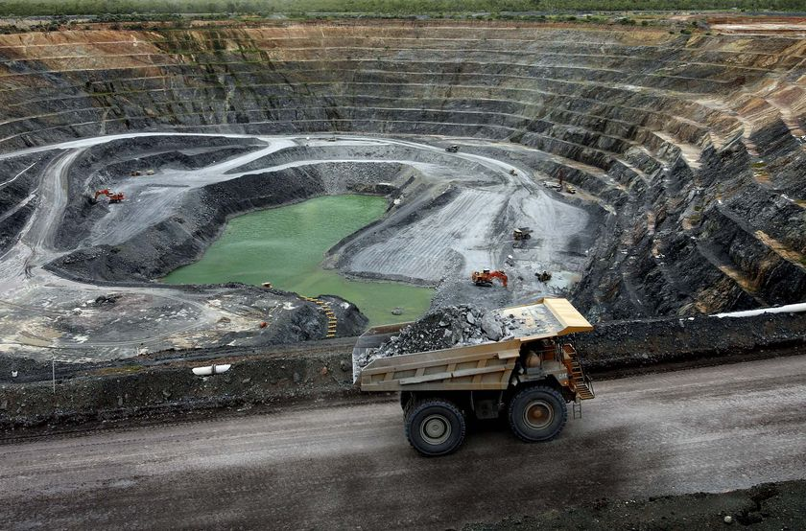
Dangerous nuclear activities 1: Uranium and thorium Mining

Slide 21
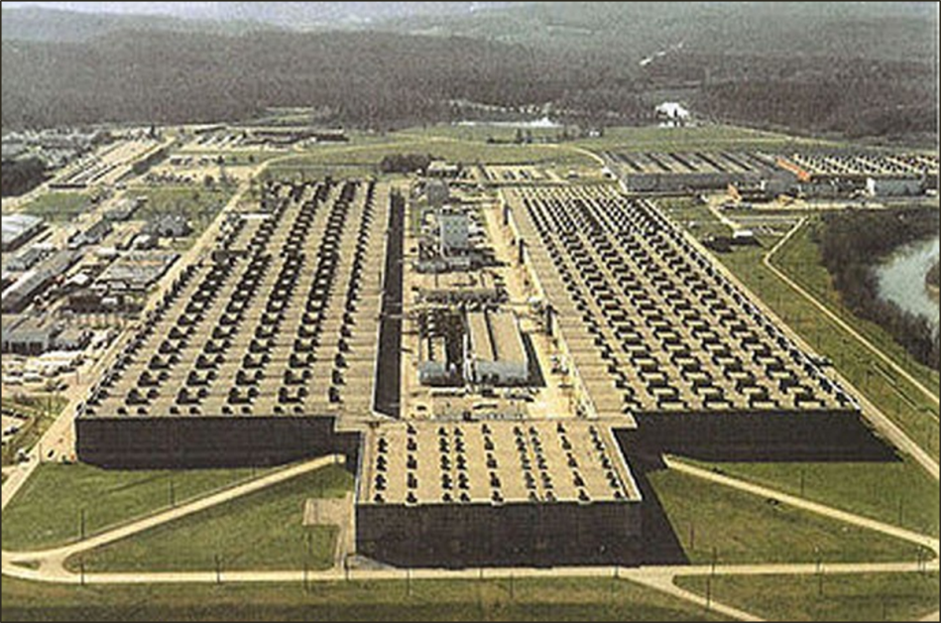
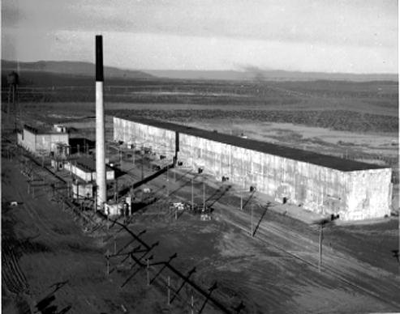

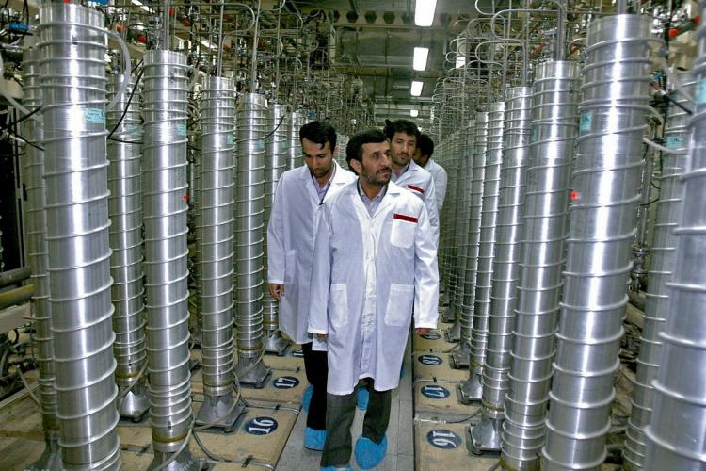
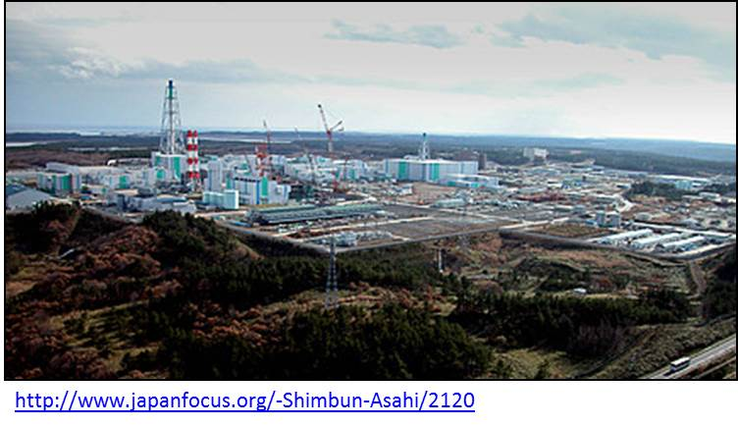
Dangerous nuclear activities 2: Nuclear Fuel Making

Slide 22
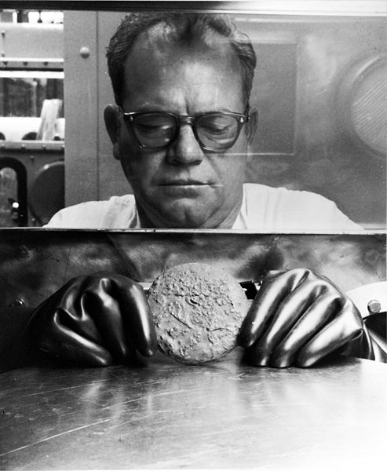
Dangerous nuclear materials 3: Plutonium & highly enriched uranium

Slide 23
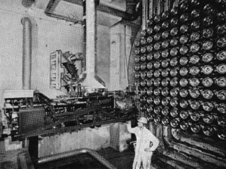
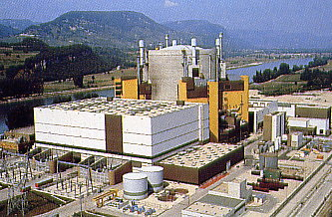
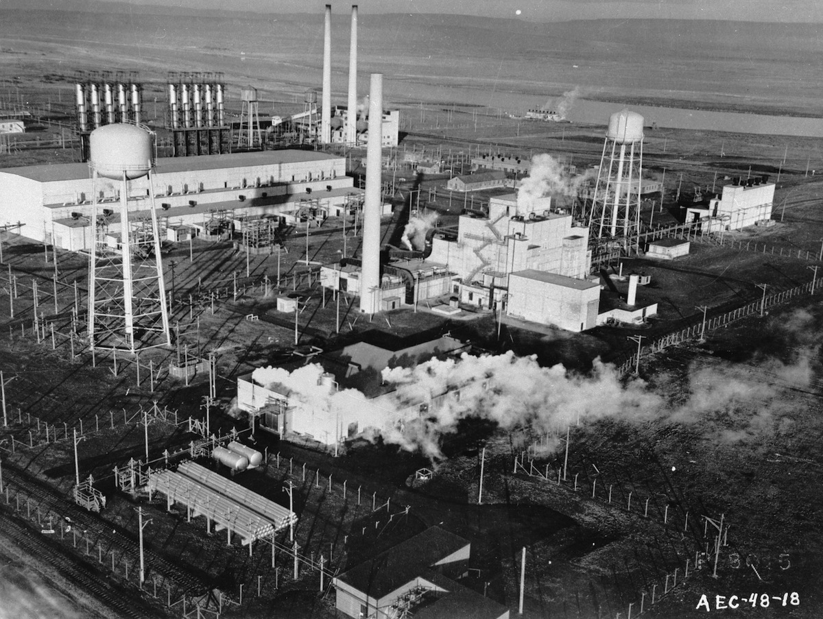
Dangerous nuclear activities 4: Reactors optimized To make weapons Plutonium
Chalk River Heavy Water Reactor, Manhattan Project
Super Phenix, Breeder Reactor, France
Hanford, graphite- moderated military production reactor

Slide 24
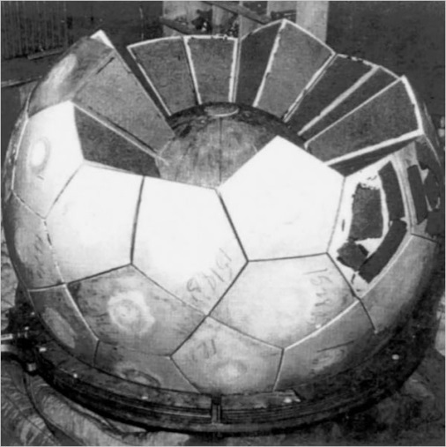
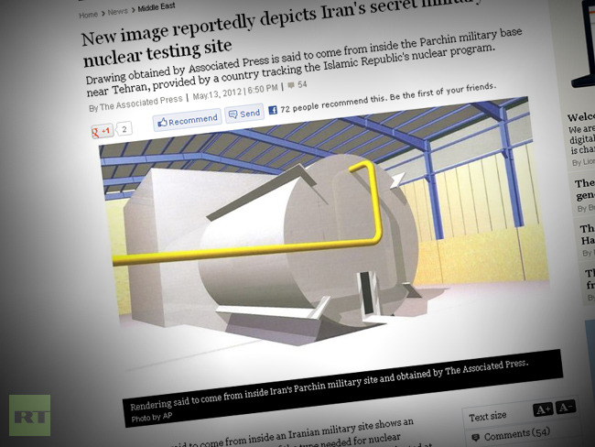
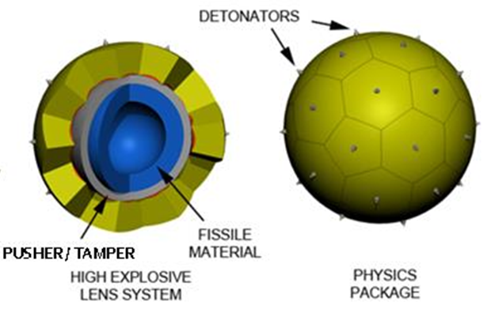
Dangerous nuclear activities 5: Research & Development into Atomic Explosives

Slide 25
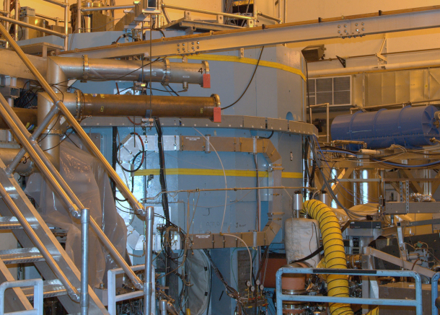
Safe nuclear activities 1:
Small research reactors

Slide 26
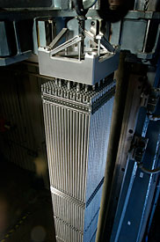
Safe nuclear materials 2:
“Denatured” Nuclear fuels

Slide 27
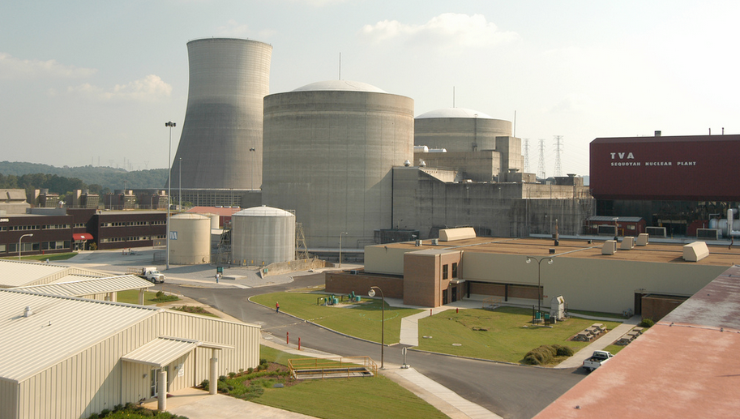
On 2nd thought, Not So Safe: Nuclear Power Plants
Sequoyah, Units 1 & 2 ©TVA

Slide 28
the Acheson-Lilienthal Report’s key concepts
There’s a distinction between “safe” and “dangerous” nuclear activities.
Uranium and plutonium can be denatured– rendered useless to make bombs.
Inspections alone are insufficient to prevent military diversions.
Timely warning is essential to prevent such diversions.
Economic market signals should be relied on to pace nuclear power development.
The geographic dispersion of dangerous nuclear facilities could be relied upon to deter “atomic war.”

Slide 29
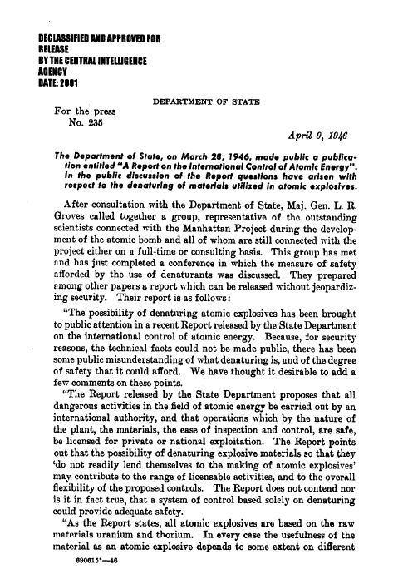
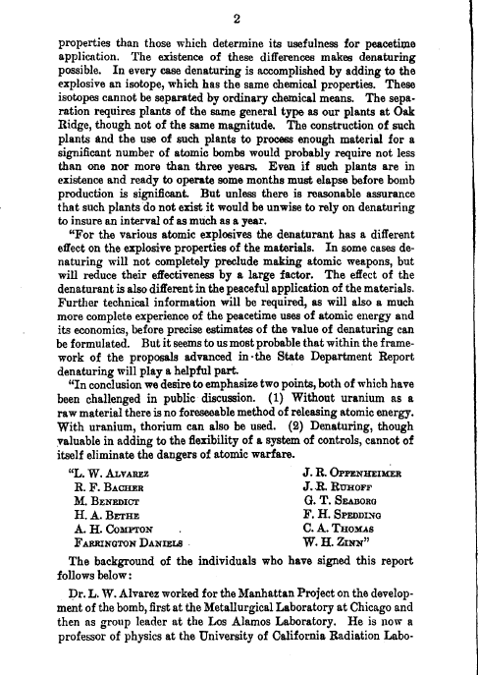
Concept 2 – Denaturing: State Department Press release 235 downplayed Denaturing April 9, 1946

Slide 30
Denaturing: not an effective safeguard
…In every case denaturing is accomplished by adding to the explosive an isotope, which has the same chemical properties. These isotopes cannot be separated by ordinary chemical means. The separation requires plants of the same general type as our plants at Oak Ridge, though not of the same magnitude. The construction of such plants and the use of such plants to process enough material for a significant number of atomic bombs would probably require not less than one nor more than three years. Even if such plants are in existence and ready to operate some months must elapse before bomb production is significant. But unless there is reasonable assurance that such plants do not exist it would be unwise to rely on denaturing to insure an interval of as much as a year.
U.S. State Department Press Release No. 235
April 9, 1946

Slide 31
Press Release downplayed the value of Denaturing Plutonium
“The Report does not contend nor is it in fact true, that a system of control based solely on denaturing could provide adequate safety… In some cases denaturing will not completely preclude making atomic weapons... Further technical information will be required, as will also a much more complete experience of the peacetime uses of atomic energy and its economics, before precise estimates of the value of denaturing can be formulated... Denaturing, though valuable in adding to the flexibility of a system of controls, cannot of itself eliminate the dangers of atomic warfare.”
U.S. State Department Press Release No. 235
April 9, 1946

Slide 32
the Acheson-Lilienthal Report’s Key concepts
There’s a distinction between “safe” and “dangerous” nuclear activities.
Uranium and plutonium can be denatured– rendered useless to make bombs.
Inspections alone are insufficient to prevent military diversions.
Timely warning is essential to prevent such diversions.
Economic market signals should be relied on to pace nuclear power development.
The geographic dispersion of dangerous nuclear facilities could be relied upon to deter “atomic war.”

Slide 33
Concept 3: A system based Solely on inspection without international ownership of dangerous activities will not work
Take the case of a controlled reactor, a power pile, producing plutonium. Assume an International agreement barring use of the plutonium in a bomb, but permitting use of the pile for heat or power. No system of inspection, we have concluded, could afford any reasonable security against diversion of such materials to the purposes of war. If nations may engage in this dangerous field, an only national good faith and International policing stand in the way, the very existence of the prohibition against the use of such piles to produce fissionable material suitable for bombs would tend to stimulate and encourage surreptitious evasions. This danger in the situation is attributable to the fact that this potentially hazardous activity is carried on by nations or their citizens.
Acheson–Lilienthal Report, March 16,1946, p. 21

Slide 34
the Acheson-Lilienthal Report’s Key concepts
There’s a distinction between “safe” and “dangerous” nuclear activities.
Uranium and plutonium can be denatured– rendered useless to make bombs.
Inspections alone are insufficient to prevent military diversions.
Timely warning is essential to prevent such diversions.
Economic market signals should be relied on to pace nuclear power development.
The geographic dispersion of dangerous nuclear facilities could be relied upon to deter “atomic war.”

Slide 35
Concept 4 -- Time Adequate: What Safeguarding against military diversions requires
Provide unambiguous and reliable danger signals if a nation takes steps that do or may indicate the beginning of atomic warfare. Those danger signals must flash early enough to leave time adequate to permit other nations—alone or in concert—to take appropriate action.
Acheson–Lilienthal Report, p. 9

Slide 36
Timely warning: measured in many months
Seizures will afford no immediate tactical advantage. They would in fact be an instantaneous dramatic danger signal, and they would permit, under the conditions stated, a substantial period of time for other nations to take all possible measures of defense. For it should be borne in mind that even if facilities are seized, a year or more would be required after seizure before atomic weapons could be produced in quantities sufficient to have an important influence on the outcome of war.
Acheson–Lilienthal Report, p. 48

Slide 37
Timely warning: Relevant Cases
Japan
Iran
Saudi Arabia

Slide 38
the Acheson-Lilienthal Report’s Key concepts
There’s a distinction between “safe” and “dangerous” nuclear activities.
Uranium and plutonium can be denatured– rendered useless to make bombs.
Inspections alone are insufficient to prevent military diversions.
Timely warning is essential to prevent such diversions.
Economic market signals should be relied on to pace nuclear power development.
The geographic dispersion of dangerous nuclear facilities could be relied upon to deter “atomic war.”

Slide 39
Global distribution of dangerous plants viewed as a hedge against war
With appropriate world-wide distribution of stockpiles and facilities; with design rendered as little dangerous as possible; with stockpiles of dangerous materials kept at the lowest level consistent with good economics and engineering; there will be no need for a sense of insecurity on the party of any of the major powers. Seizures will afford no immediate tactical advantage. They would in fact be an instantaneous dramatic danger signal, and they would permit, under the conditions stated, a substantial period of time for other nations to take all possible measures of defense. For it should be borne in mind that even if facilities are seized, a year or more would be required after seizure before atomic weapons could be produced in quantities sufficient to have an important influence on the outcome of war.

Slide 40
A-L Report recommended relying on economic market signals to locate power plants
The problem of power producing piles should be somewhat less difficult in the case of the non-dangerous plants. In these, fissionable materials will be denatured. The charter should be able to provide for their allocation of this type of plant in accordance with more conventional economic standards. It might be possible to provide that they should be located on the basis of competitive bids among interested nations. On such a basis, countries with ample power resources in water, coal, or oil would limit their bids to those warranted by the costs of alternative sources.
Acheson–Lilienthal Report, p. 49

Slide 41
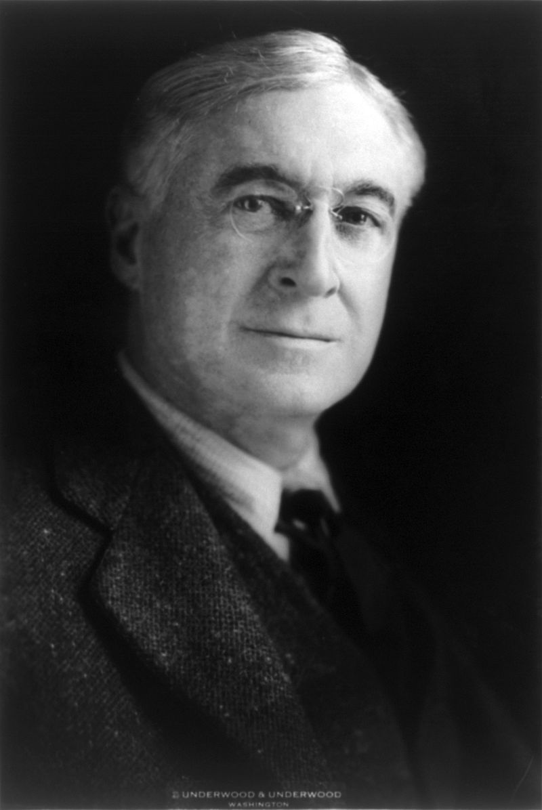
Bernard Baruch

Slide 42
new points of the Baruch plan
Condign Punishment
Required majority UN Security Council vote for enforcement
Requirement that Russia be inspected before U.S. nuclear disarmament

Slide 43
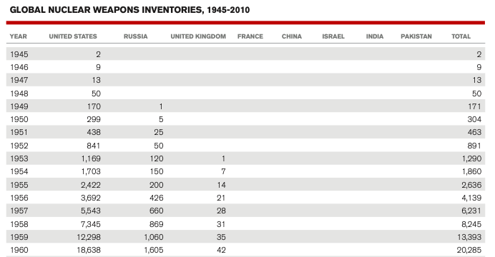
U.S. Initially Curtailed Nuclear Production

Slide 44
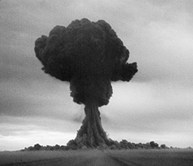
Russian nuclear test killed the baruch plan
August 29, 1949

Slide 45
II. What did the earliest Strategic control initiatives see as the nuclear war threats to be controlled?
The end of the Truman Administration and Eisenhower’s Atoms for Peace Program

Slide 46
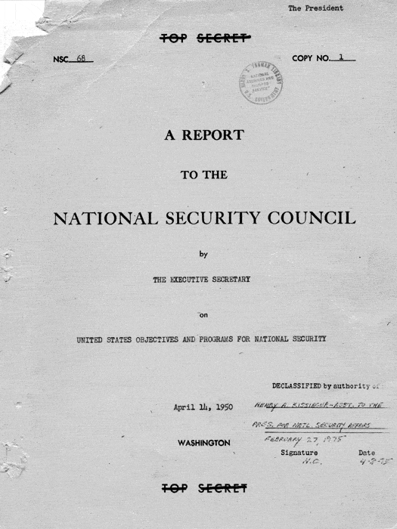
NSC 68 described the “knockout blow” threat
April 14, 1950

Slide 47
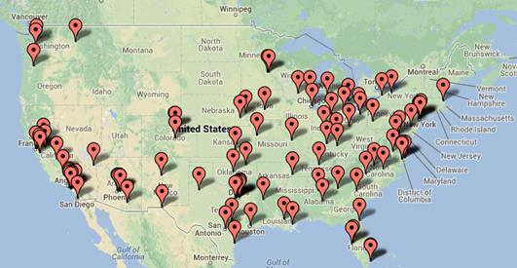
NSC 68 estimated Moscow could KnockOut Top 100 U.S. Cities by 1954
100 Largest US Cities by Population*
Anchorage, AK and Honolulu, HI not shown on map

Slide 48
The next nuclear war: would target America’s 100 largest cities
“It is believed that the Soviets cannot deliver their bombs on target with a degree of accuracy comparable to ours, but a planning estimate might well place it at 40-60 percent of bombs sortied. For planning purposes, therefore, the date the Soviets possess an atomic stockpile of 200 bombs would be a critical date for the United States, for the delivery of 100 atomic bombs on targets in the United States would seriously damage this country.” NSC 68

Slide 49
Panel of consultants recommended Reduce stockpiles to prevent a knockout blow, Jan. 1953
…Atomic bombs can be decisive only if they are delivered on the target in considerable numbers (The American requirement for a knockout atomic attack on the Soviet Union now runs well into four figures.)...It seems reasonable to say, then, that much would be achieved if it should be possible to get a reduction in the size of stockpiles and bombing fleets such that neither side need fear a sudden knockout from the other.
“Report by the Panel of Consultants of the Department of State to the Secretary of State,” Washington, January 1953, Annex 1.

Slide 50
How many bombs the Ussr needed to knock out America: 600 – 15,000
…It will be a pleasant surprise if the defense is ever able to knock down or deflect as many as four out of five of the attackers, and at present we should be lucky to get one in five.. the Soviet Union may be able to destroy our economy beyond the hope of recovery when she has 15,000 atomic bombs, while she might well have this ability when she has as few as 600. The lower figure might be reached in a few years, and the upper is not out of reach within the next two decades.
“Report by the Panel of Consultants of the Department of State to the Secretary of State,” Washington, January 1953, Part II, Section A.

Slide 51
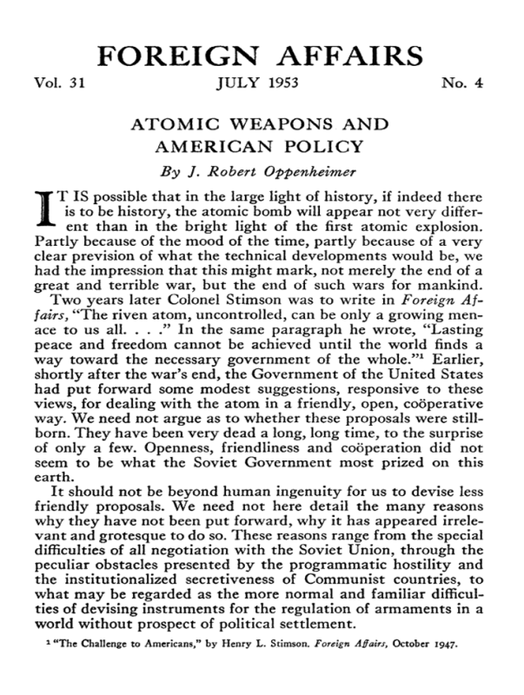
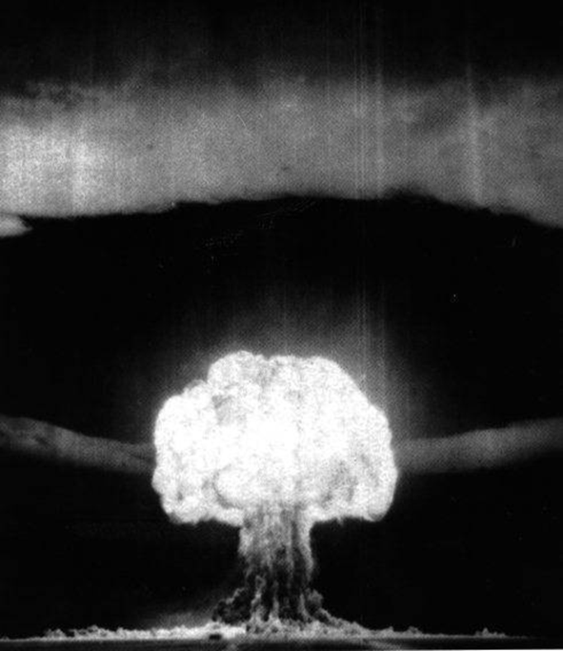

CATALYSTS IN 1953 FOR “OPERATION CANDOR”
Panel of Consultants on Disarmament Report, early ‘53
“We may be likened to two scorpions in a bottle, each capable of killing the other but only at the risk of his own life”
Joe-4 “Alarm Clock” Test, Aug. 12, ‘53

Slide 52
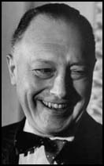
C.D. Jackson: Ike’s psychological warfare advisor headed operation candor

Slide 53
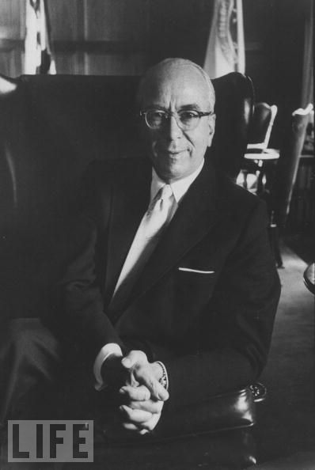
Lewis Strauss: Eisenhower's nuclear advisor, another major Player

Slide 54

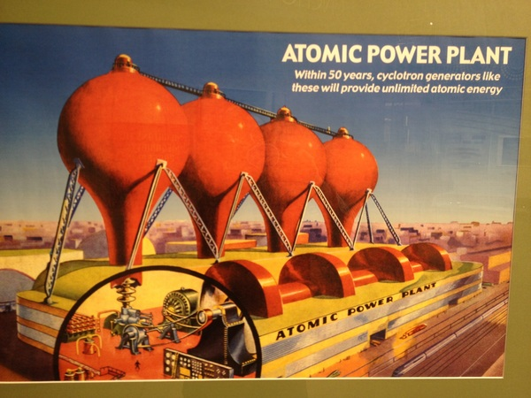

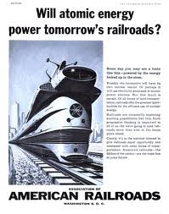
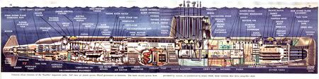
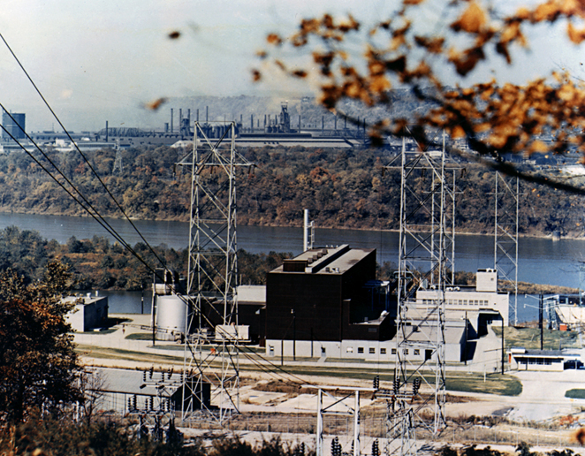
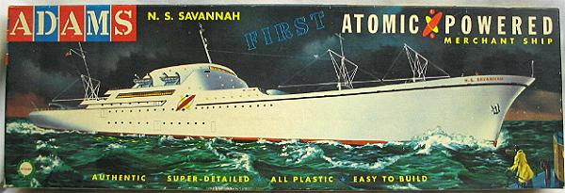
Nuclear Energy: 1950s Killer APp

Slide 55
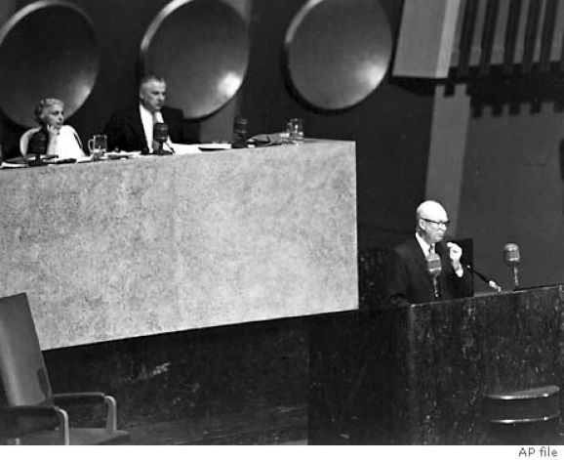
atoms for peace assumed the knockout blow threat
Eisenhower argued that even a “vast superiority in numbers of weapons, and a consequent capability of devastating retaliation, is no preventive of itself against the fearful material damage” that would be inflicted by a surprise attack and an aggressor “in possession of the effective minimum number of atomic bombs for a surprise attack” could cause hideous damage even against the most defended of nations.
Dwight D. Eisenhower, “Atoms for Peace,” address to the 470th Plenary Meeting of the UN General Assembly, New York, December 8, 1953.

Slide 56
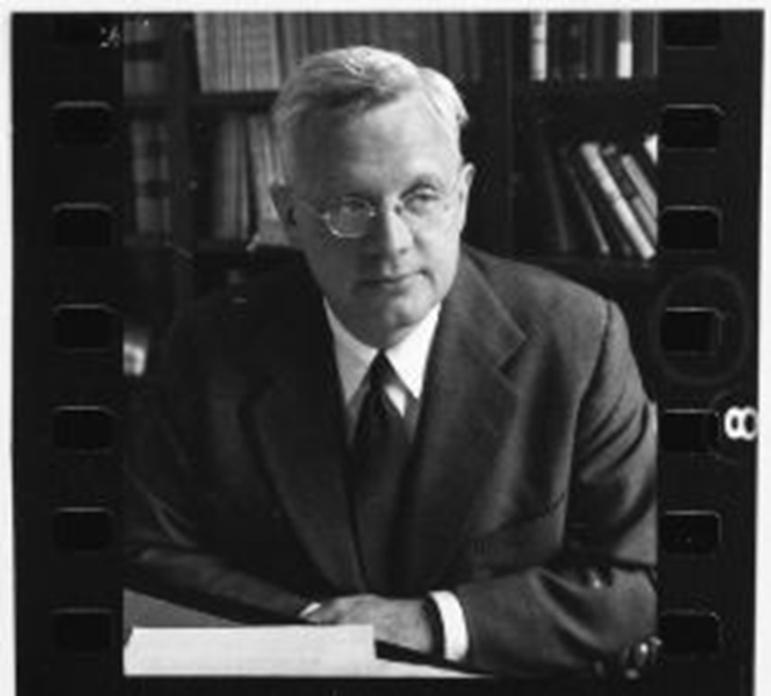
Robert Bowie: led atoms for peace implementation study

Slide 57
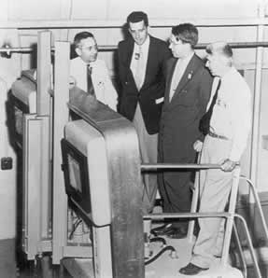
ATOMS for peace Geneva conference proliferated plutonium know how August 8-20, 1955

Slide 58
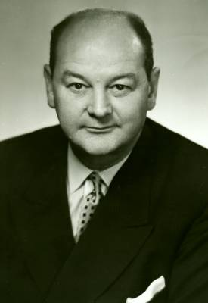
U.S. Ambassador to the Un Questioned key Atoms for Peace assumptions
James Wadsworth

Slide 59
What was assumed Safe Under Atoms for peace
Storage of fissile material
Any production activity that could not produce a knockout blow stockpile of several scores of weapons without being detected

Slide 60
Atoms for Peace safeguards: Why they needn’t be “perfect”
“even under the most effective controls…a future government [could] divert without the knowledge of inspectors …fissionable materials from which twenty, forty or even fifty multi-megaton bombs could be fabricated….[but] 100 percent perfection of inspection [was unnecessary]… nor would there be terrible consequences…because those few weapons would be…deterred by the remaining capability in the hands of nations on various sides.”
Harold Stassen
U.S. UN Ambassador
March 20, 1957

Slide 61
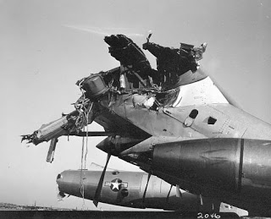
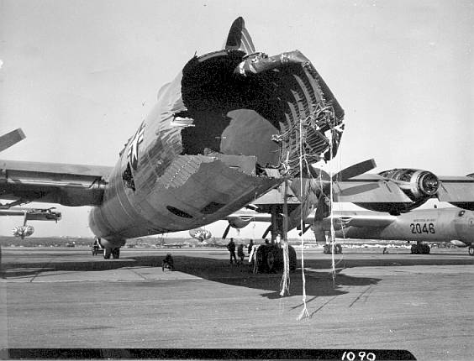
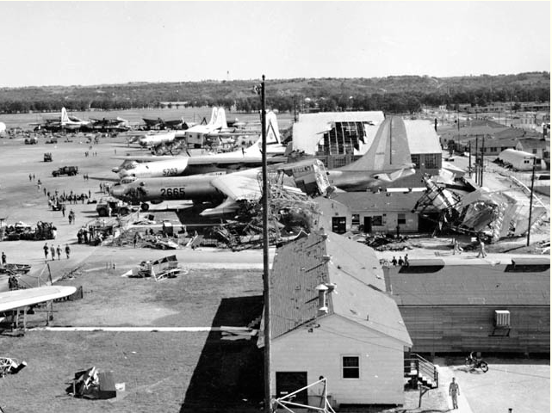
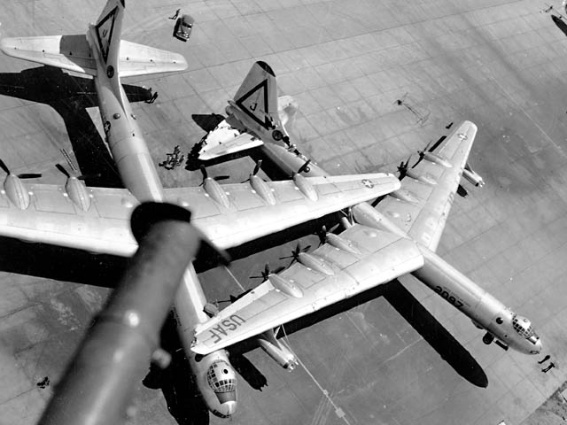
But Vulnerable sac bases, Not U.S. Cities were real targets
Tornado Damaged 76 B-36s at Carswell AFB, 9/1/52

Slide 62
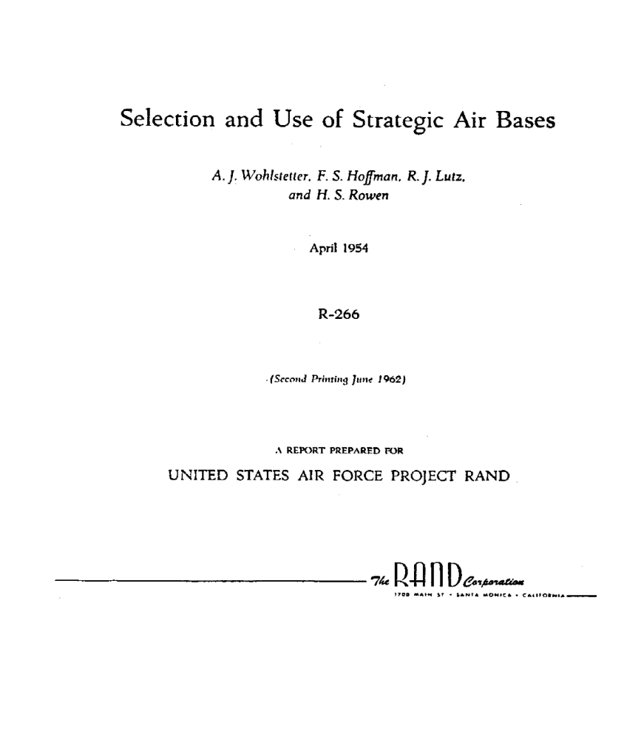
NOT HUNDREDS OR THOUSANDS OF BOMBS, BUT ONLY SCORES WERE NEEDED TO DESTROY SAC BASES IN 1953

Slide 63
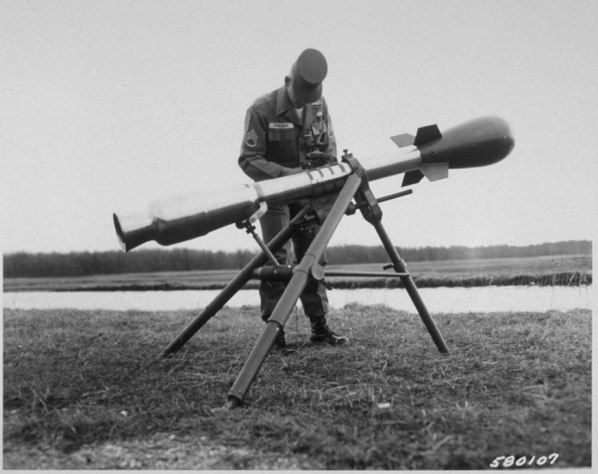
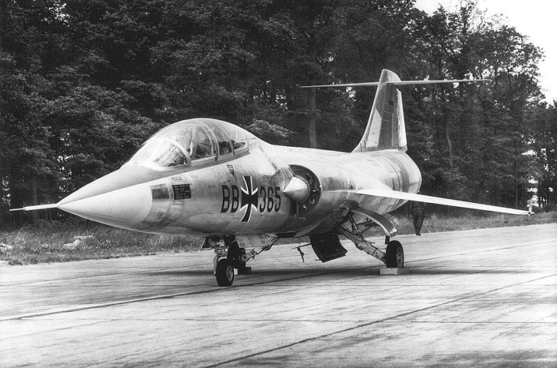
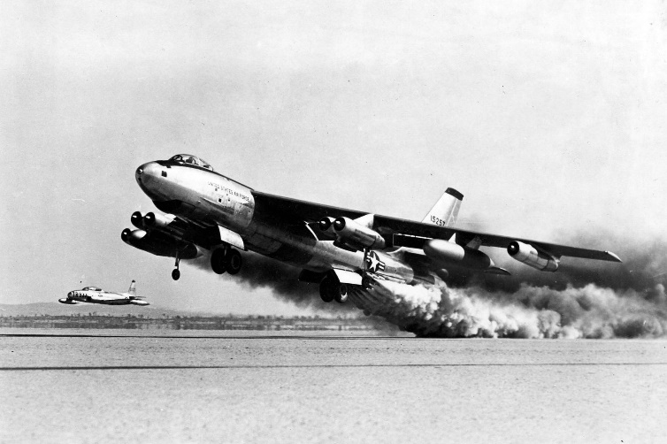

Not scores, just one Weapon a threat: Catalytic and Accidental Wars
F-104 Starfighter, 1950s-60s
“Widow Maker”
Davy Crockett, 1950s-60s
Suez, 1956
Nuclear B-47 crashes (4 in ‘50s)

Slide 64
Atoms for Peace: perhaps the most significant of nonproliferation Policy failures
“…one of the most inexplicable political fantasies in history. Only a social psychologist could hope to explain why the possessors of the most terrible weapons in history should have sought to spread the necessary industry to produce them in the belief that this could make the world safer”
Leonard Beaton, Must the Bomb Spread?,
Baltimore: Penguin Books, 1996, pp. 88-89.

