Slide 1
Nuclear and non-nuclear energy trends
A presentation by
Henry Sokolski
Executive Director
Nonproliferation Policy Education Center
www.npolicy.org
© Nonproliferation Policy Education Center

Slide 2
Questions to be Answered
Why bother with energy economics?
What are the basics of electricity production, consumption, distribution, and storage that help determine the costs of different electrical options?
How do nuclear and non-nuclear forms of energy perform economically at home and abroad?

Slide 3
Short answer to Question I
A. Assessing the quality of a country’s energy policies is a way to assess how sound its government is.
B. If an energy activity is uneconomic (e.g. reprocessing nuclear fuel), countries ought to be less insistent they have an inalienable right to pursue it. In this way, energy market signals might fortify nuclear nonproliferation (or not).
C. Assessing the costs of electrical power, distribution, and storage systems helps discern likely energy futures.

Slide 4
Short Answer to Question II
They’re complicated

Slide 5
short Answer to Question III
Natural gas is still replacing coal much more than nuclear power is both here and abroad.
Renewables and electrical storage will compete against future investments in natural gas over the next two decades
Nuclear power’s economic future depends on: 1) making a design breakthrough that makes it far less costly and 2) how willing nations are to subsidize nuclear energy to overrule market signals
Distribution and storage innovations could reduce demand for any type of large electrical generator
Demand to reduce greenhouse gases, even if it’s taxed, is unlikely to change the above

Slide 6
II. Electric power basics

Slide 7
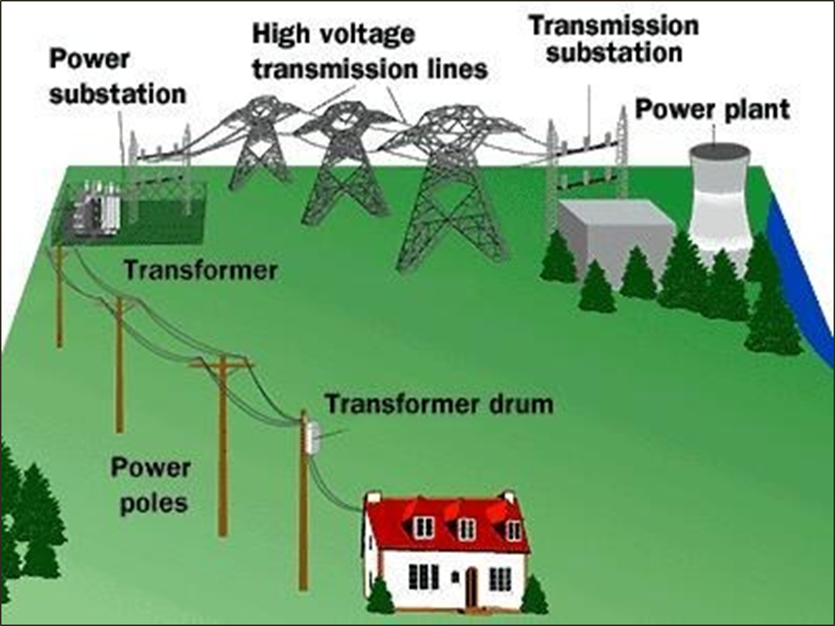
Basic electrical grid

Slide 8
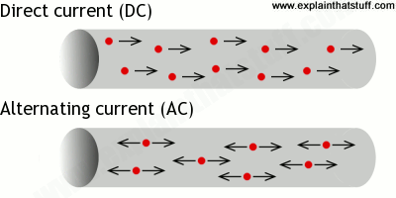
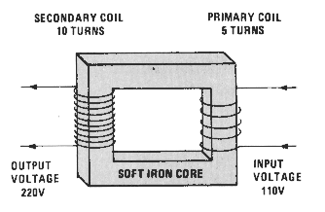
Alternating and direct current
AC Transformer basics

Slide 9
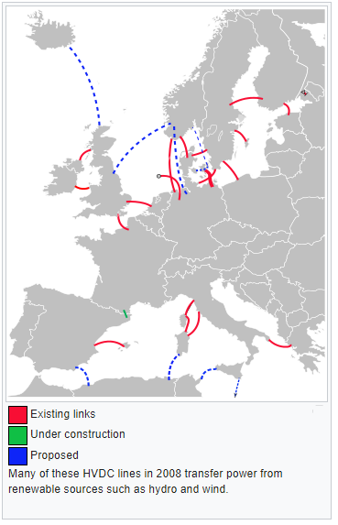
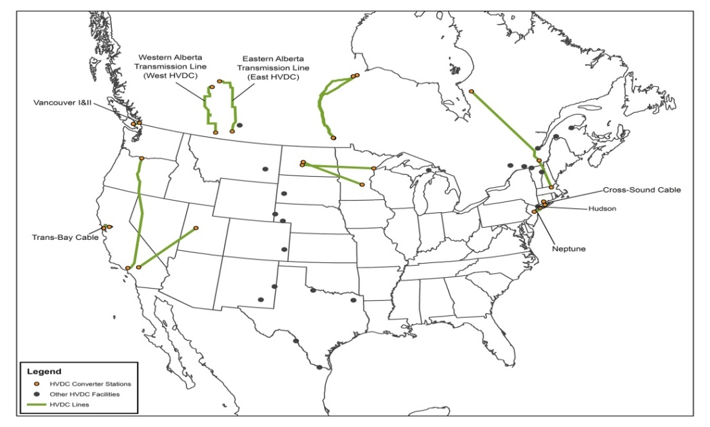
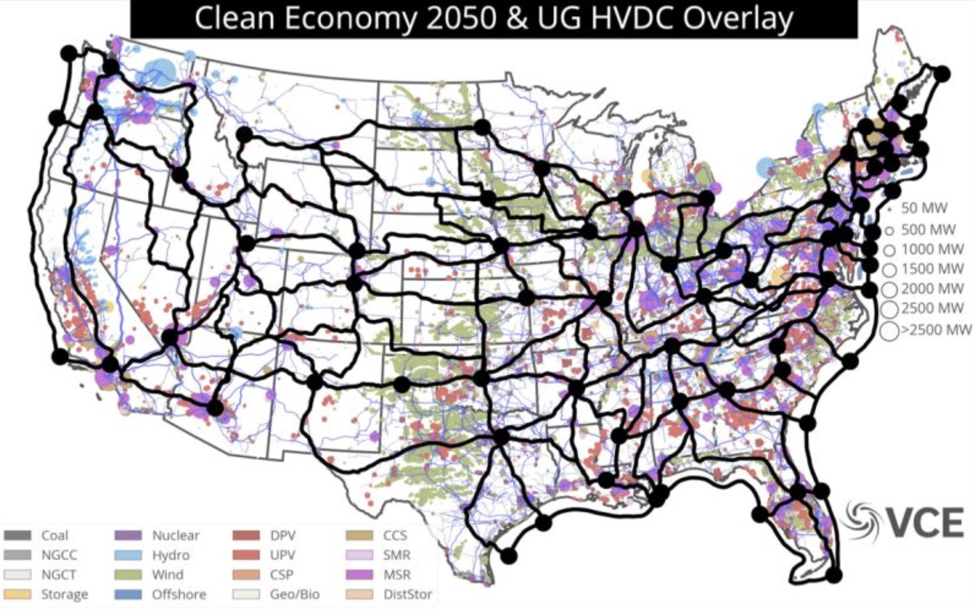
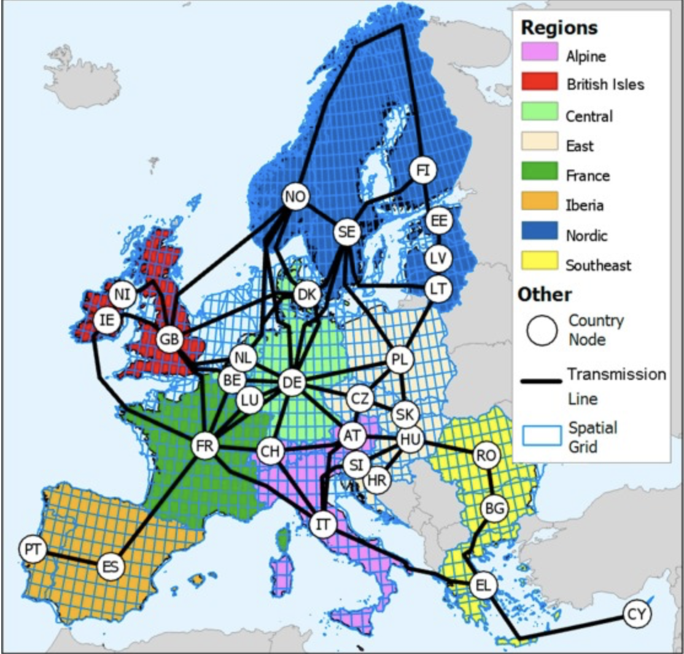
DC voltage lines Will become more prevalent in advanced economies

Slide 10
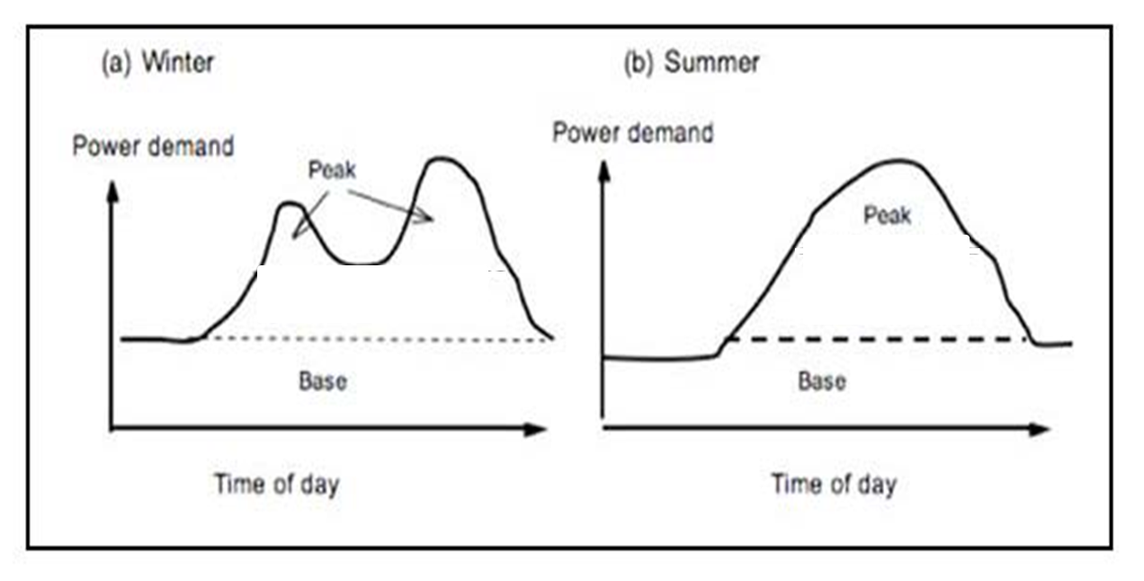
Base and peak load power demand

Slide 11
Popular Base load electrical generators
COAL
NATURAL GAS
HYDRO
NUCLEAR

Slide 12
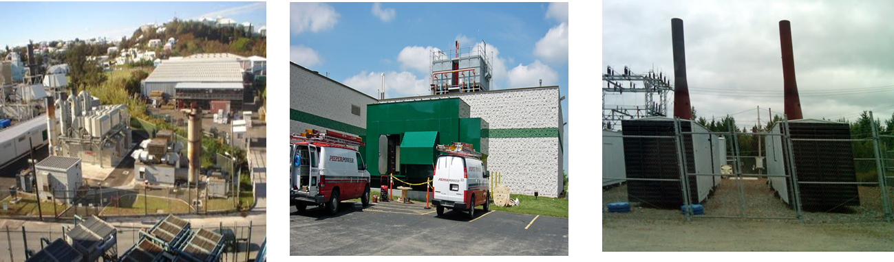
Popular Peak load generators
Small natural gas, diesel, propane-fueled plants

Slide 13
electrical distribution systems

Slide 14
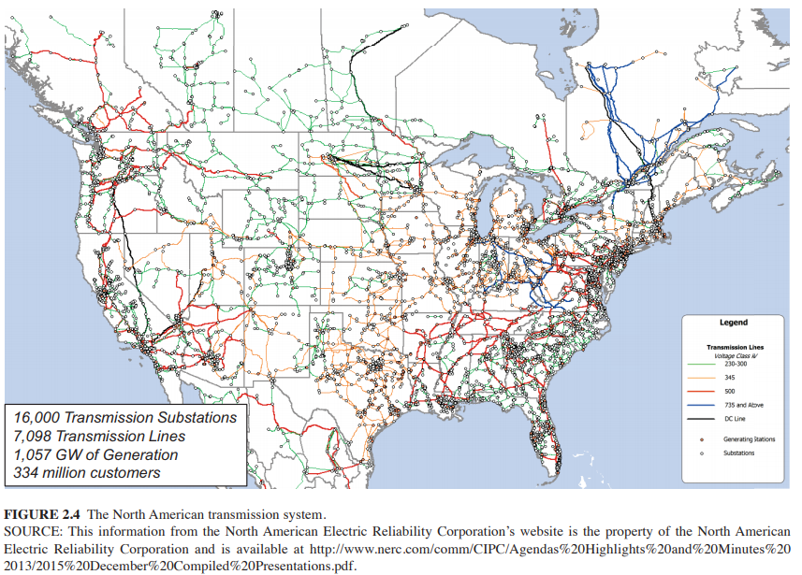
N. American transmission system is Mature, complex, and international

Slide 15
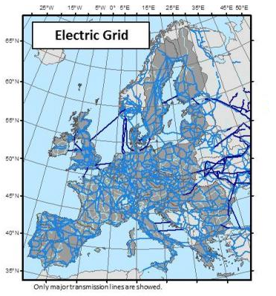
European electrical grids are also robust
http://ses.jrc.ec.europa.eu/gas-and-power-modelling

Slide 16
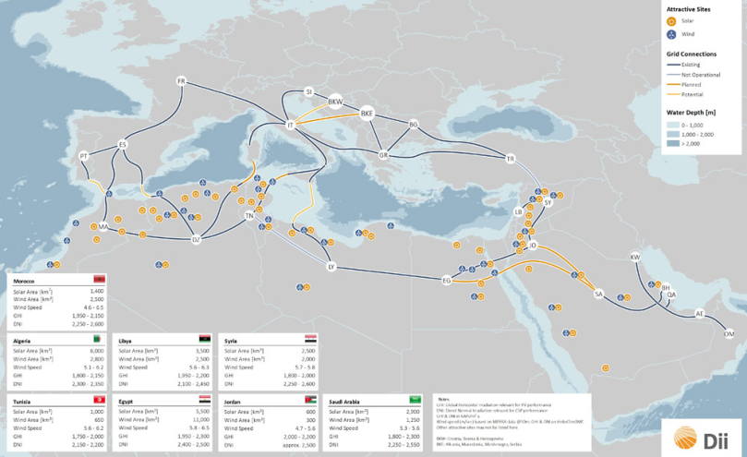
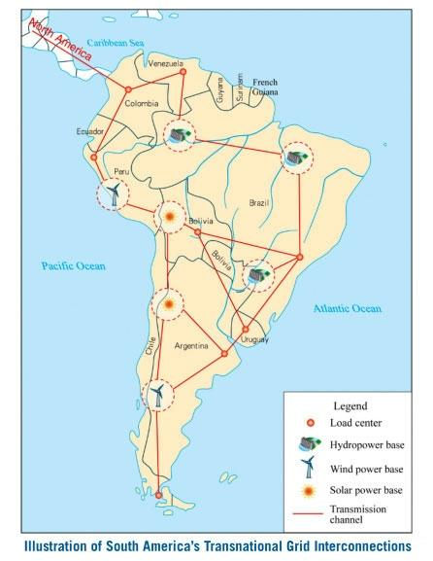
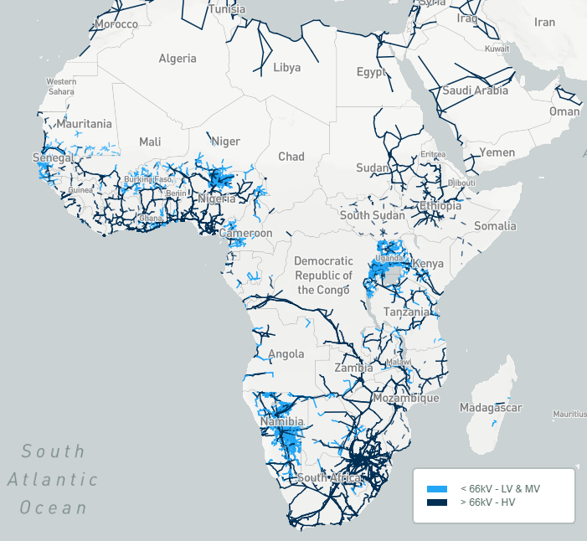
L. America, Africa, Middle East electrical transmission lags behind

Slide 17
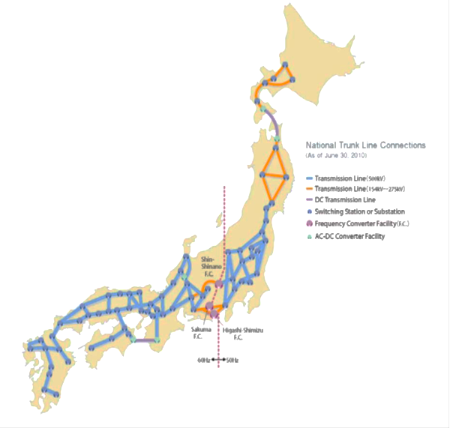
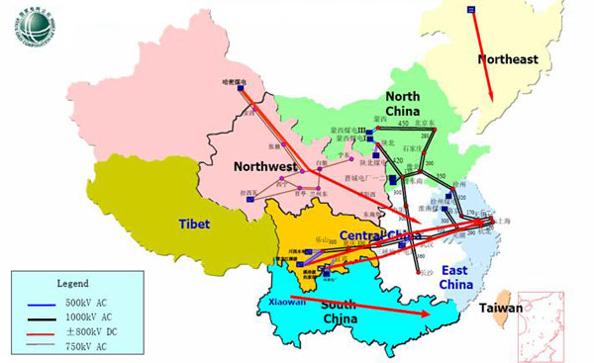
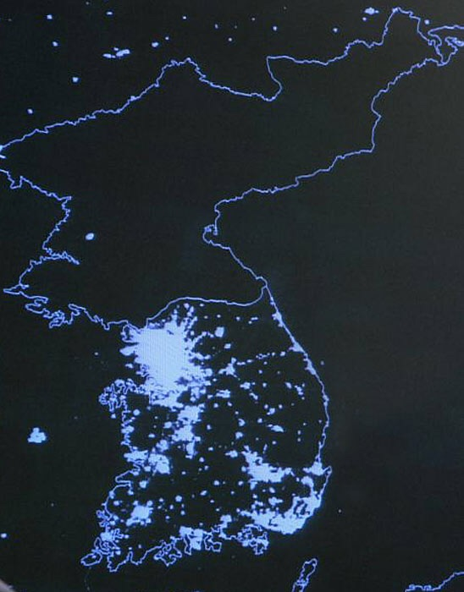
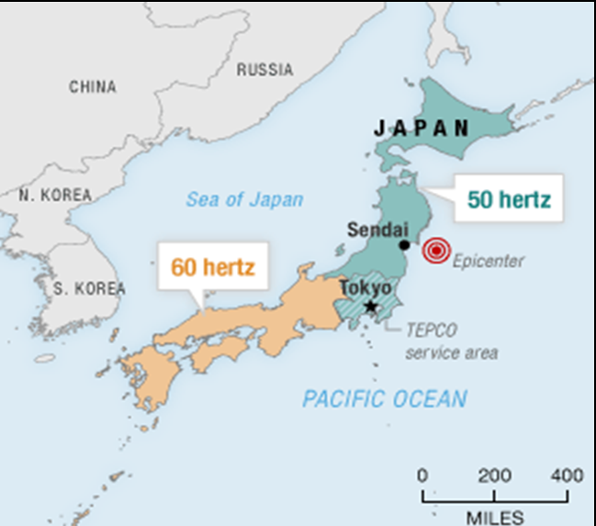
E. Asia's current national grids are suboptimal

Slide 18
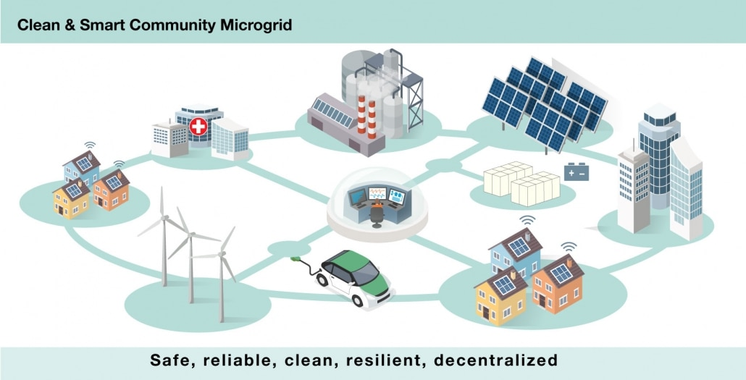
Microgrids: an Alternative to centralized generation

Slide 19
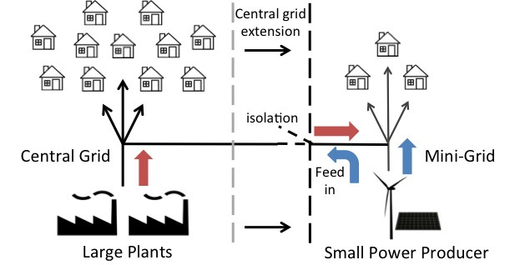
Islanding allows connection to the grid and the ability to work independently of it

Slide 20
III. Economics of Nuclear vs. non-nuclear power: natural gas substitution for coal and nuclear

Slide 21
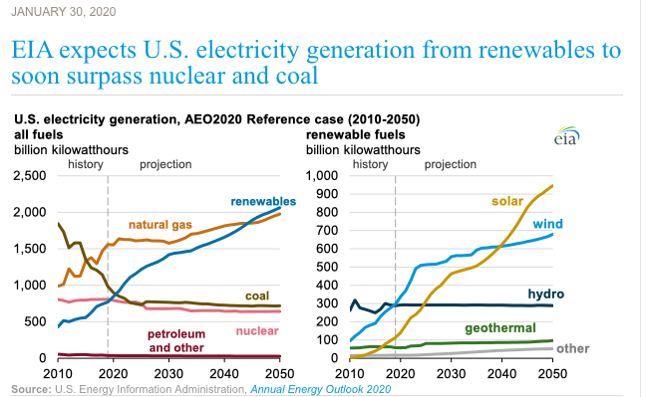
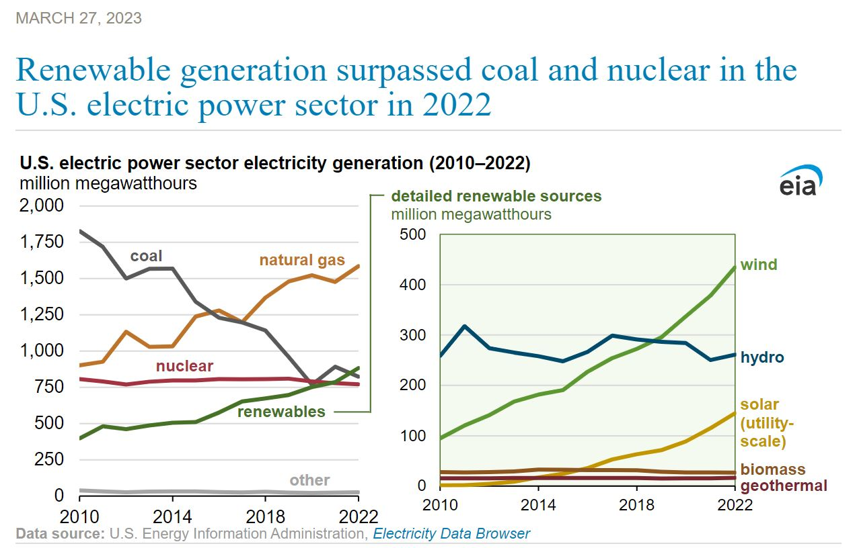
US natural gas: firing more electrical generation
https://www.eia.gov/todayinenergy/detail.php?id=42655
https://www.eia.gov/todayinenergy/detail.php?id=55960#:~:text=We%20forecast%20that%20the%20solar,year%20to%2017%25%20in%202023.

Slide 22
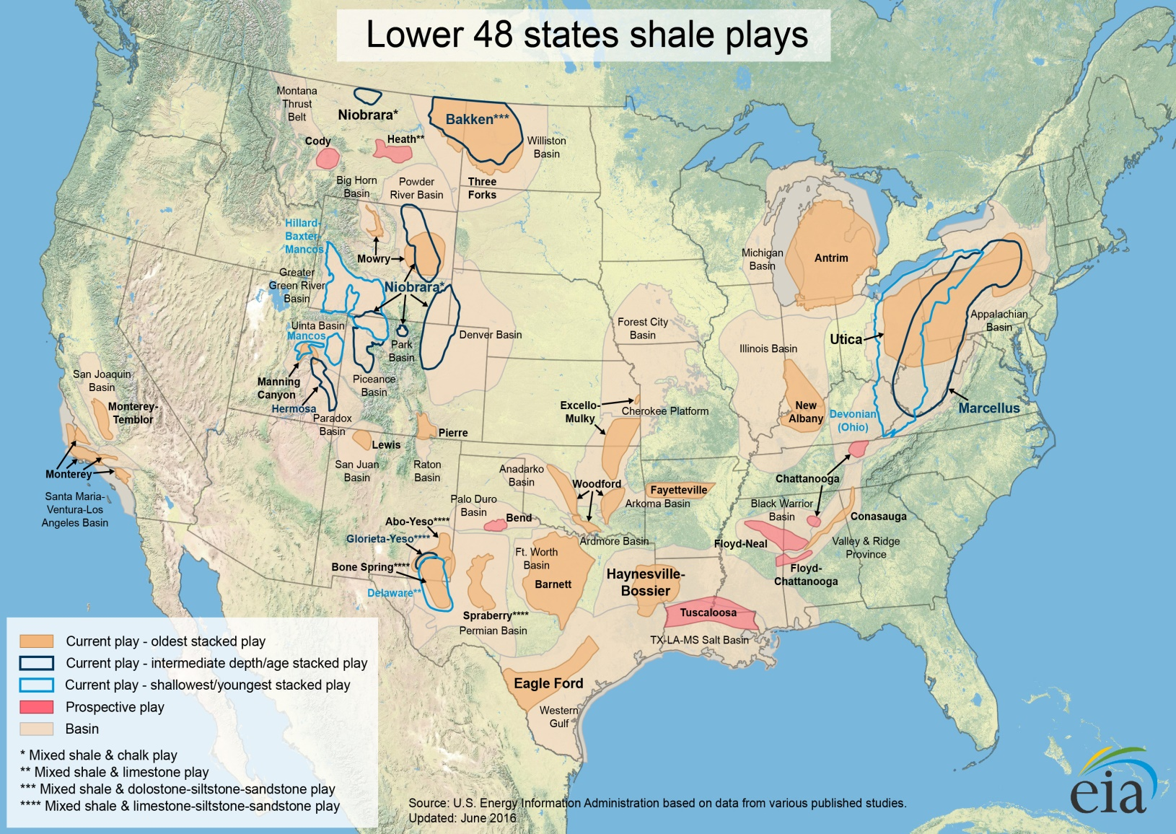
US natural gas resources, 2016
https://www.eia.gov/maps/maps.htm

Slide 23
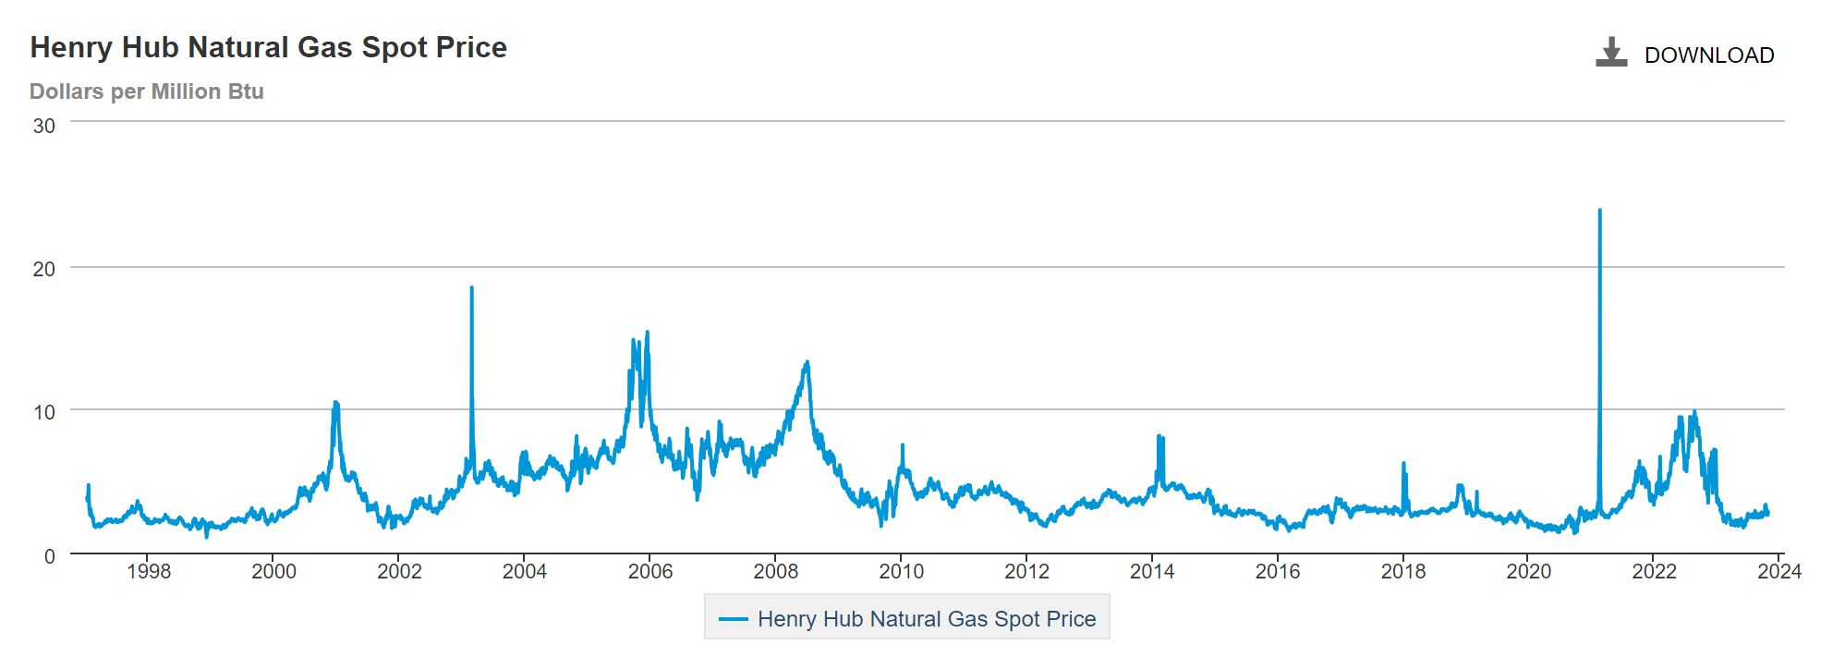
Henry Hub natural gas spot price
Current Spot Price: 2.34 (October 2024)
https://www.eia.gov/dnav/ng/hist/rngwhhdd.htm

Slide 24
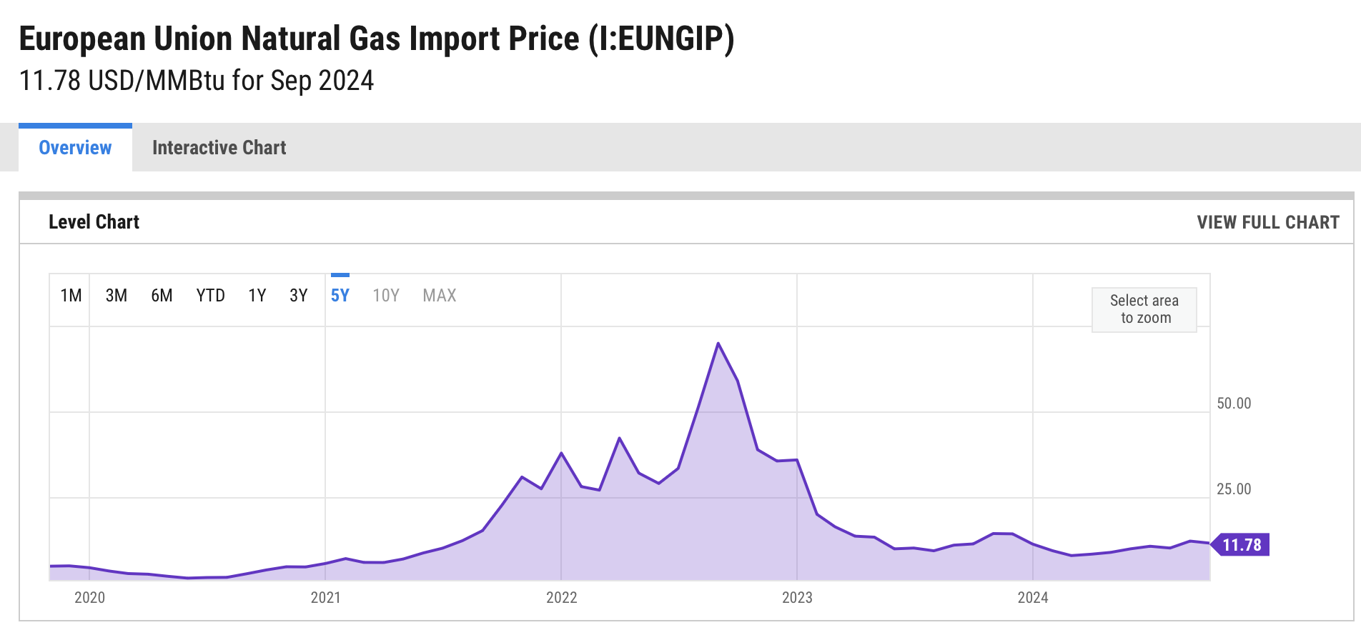
Spot price of European natural gas
https://ycharts.com/indicators/europe_natural_gas_price

Slide 25
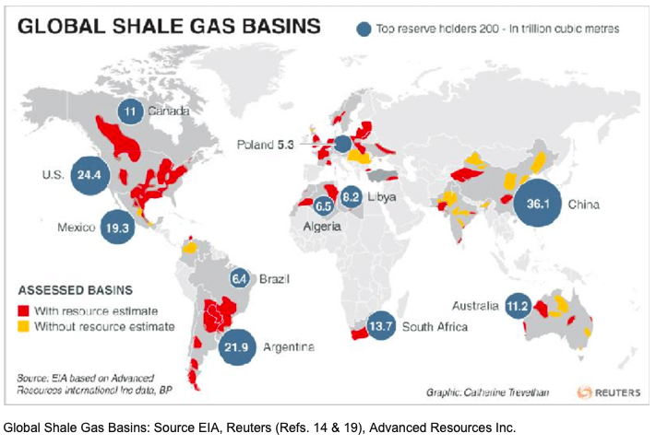
Global shale gas basins, top reserve holders
February 2018
https://www.researchgate.net/figure/Global-Shale-Gas-Basins-Source-EIA-Reuters-Refs-14-19-Advanced-Resources-Inc_fig1_323691748

Slide 26
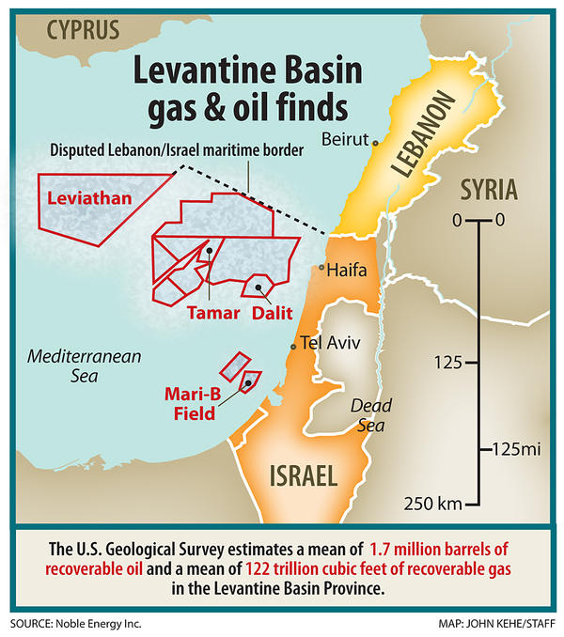
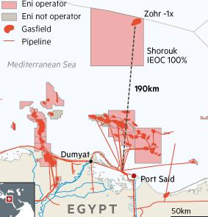
Levantine and Zohr: Massive natGAS discoveries

Slide 27
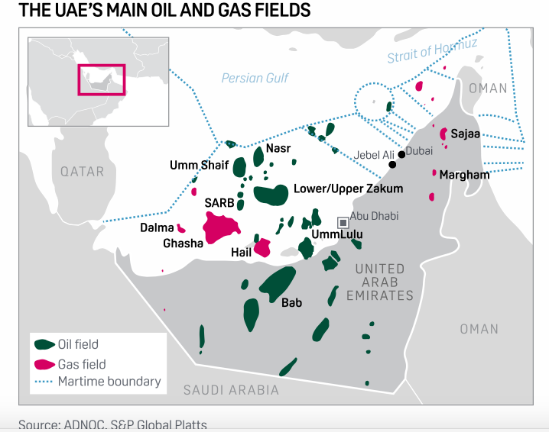
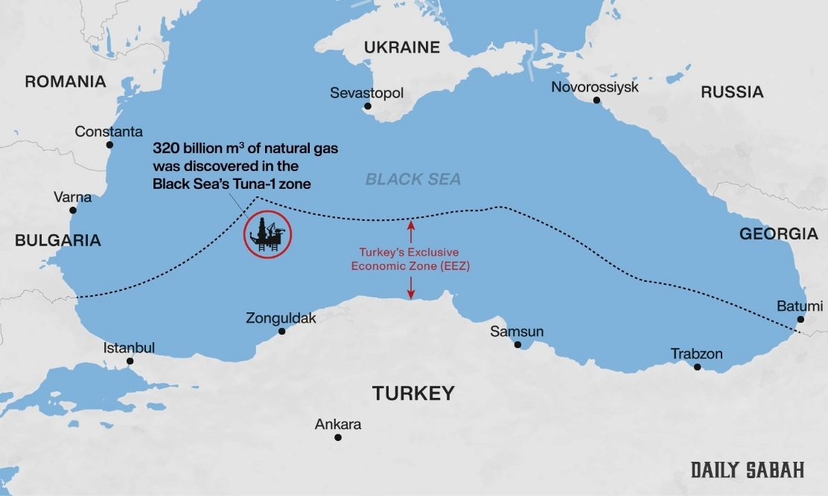
Recent UAE gulf and Turkish Black sea gas discoveries
The biggest gas find in 15 years, UAE now self sufficient
https://www.google.com/imgres?imgurl=https://steelguru.com/uploads/news/turkey-black-sea-natural-gas-discovery_5704.jpg&imgrefurl=https://steelguru.com/gas-oil/turkey-announces-black-sea-natural-gas-discovery/562466&tbnid=aP0BTkaLcb9fhM&vet=1&docid=fY4K_2qraRB1yM&w=1668&h=1000&hl=en&source=sh/x/im
https://www.spglobal.com/platts/es/market-insights/latest-news/natural-gas/020320-adnoc-to-develop-huge-onshore-gas-find-near-dubai

Slide 28
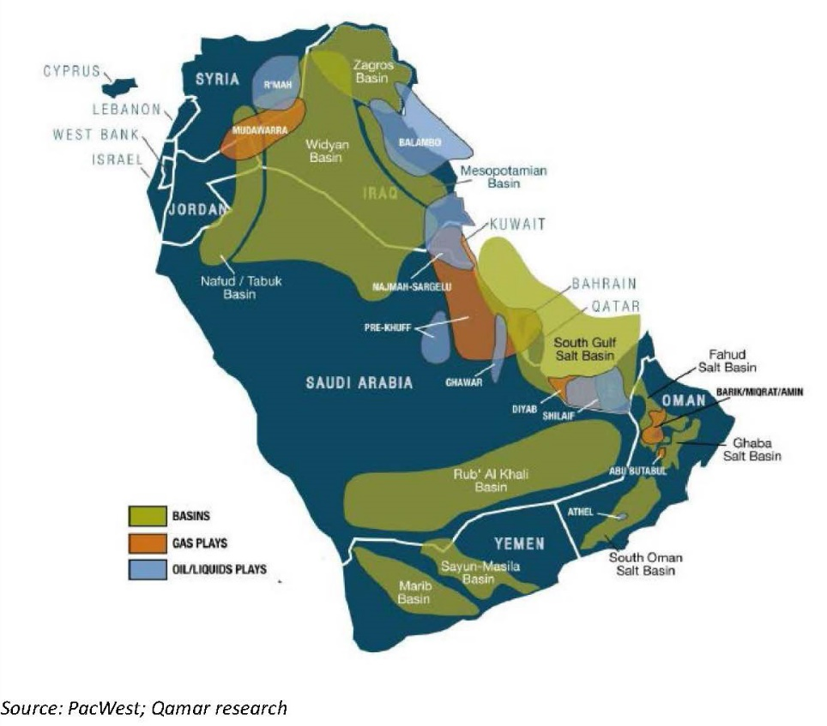
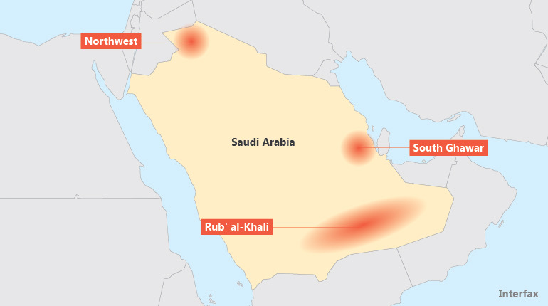
Saudi Arabia New Gas Options
https://www.eia.gov/beta/international/analysis_includes/countries_long/Iran/pdf/iran_bkgd.pdf
https://interfaxenergy.com/article/22179/saudi-aramco-presses-on-with-shale-gas
2 reactors at $12-24 b versus $334 billion for shale gas development by 2025

Slide 29
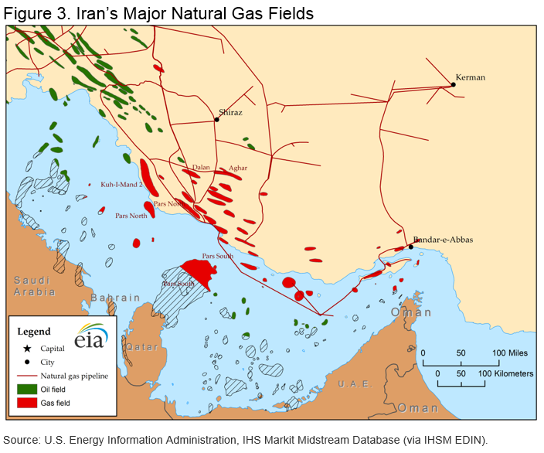
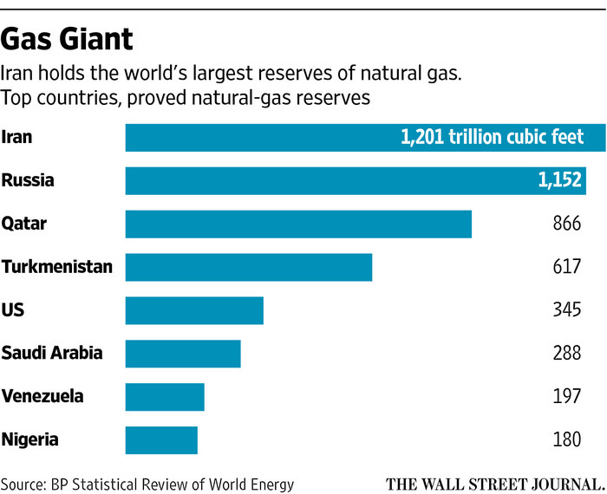
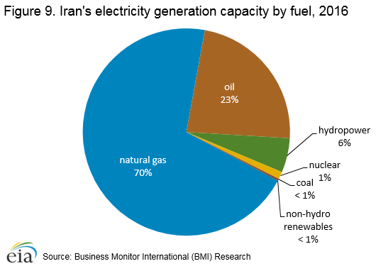
Iranian Gas
https://www.eia.gov/beta/international/analysis_includes/countries_long/Iran/pdf/iran_bkgd.pdf
https://www.wsj.com/articles/iran-seeks-rapid-reboot-for-natural-gas-exports-1453821547
Notes:
Stop here for end of part 1

Slide 30
Economics of Nuclear vs. non-nuclear power

Slide 31
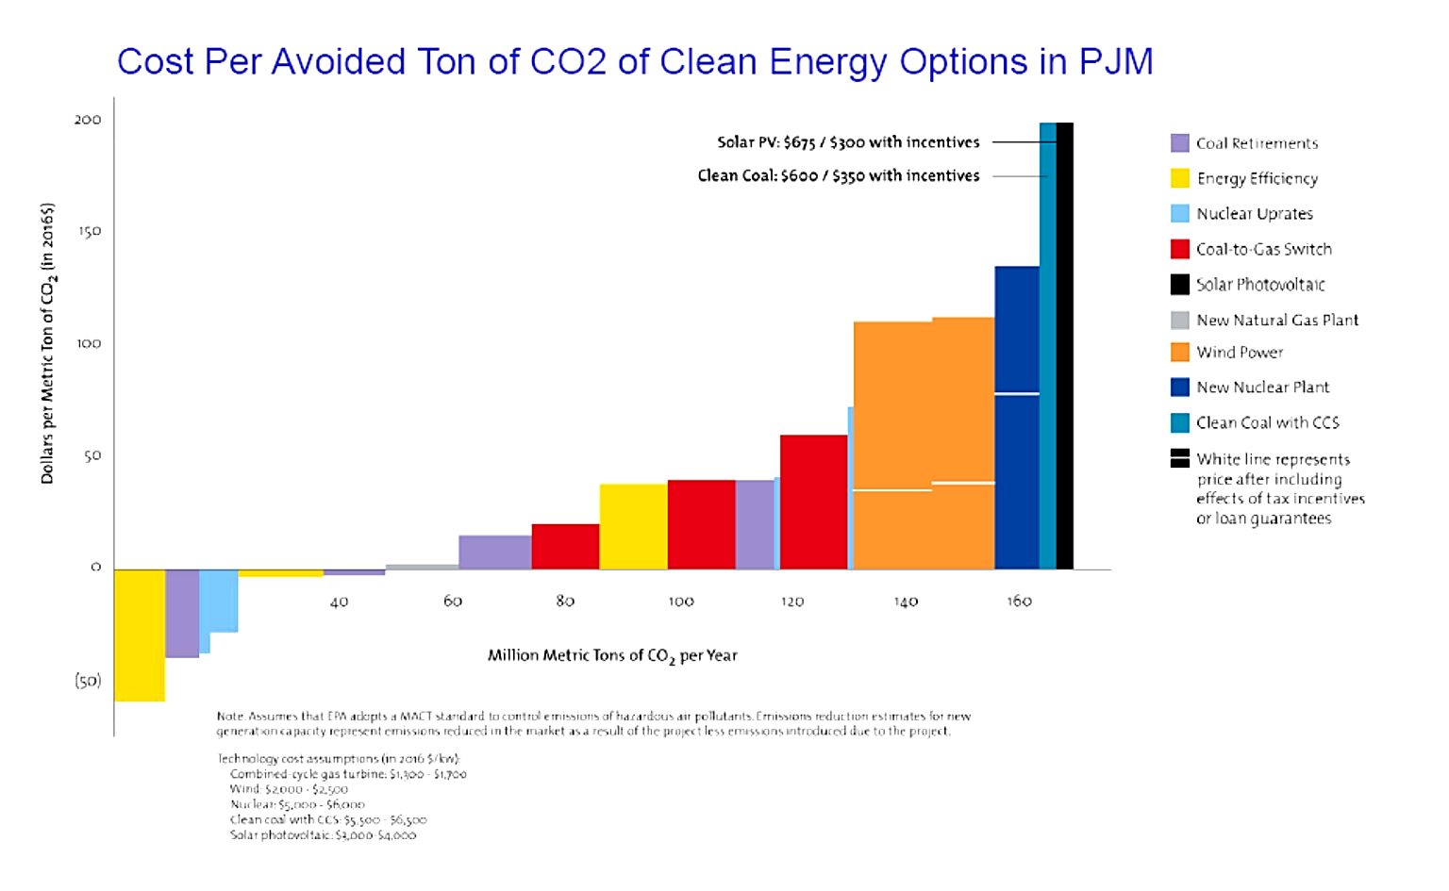
Abating carbon should start with the cheapest, quickest methods 1st
200
150
100
50
0
(50)
Coal Retirements
Energy Efficiency
Nuclear Uprates
Coal-to-Gas Switch
Solar Photovoltaic
New Natural Gas Plant
Wind Power
New Nuclear Plant
Clean Coal with CCS
White line represents
price after including
effects of tax incentives
or loan guarantees
Solar PV: $675 / $300 with incentives
Clean Coal: $600 / $350 with incentives
Dollars per Metric Ton of CO₂ (in 2016$)
40 60 80 100 120 140 160
Million Metric Tons of CO₂ per Year
Million Metric Tons of CO₂ per Year
Source: Exelon

Slide 32
Break Even #s for building New nuclear Makes government subsidies essential
To build a reactor in 2011 cost $9.8 billion. In 2024 dollars, that reactor would cost $18.44 billion to build – 88% more. This increases the natural gas break even price to $20.64 per MBTU and the CO2 tax number to $46.90 per ton.
Spot natural gas prices: CO2 Gas Number:
US: $2.34 MBTU No national market
EU: $11.78 MBTU $68.16 per ton
East Asia: $15.65 MBTU No market
Bottom Line: Nuclear construction today only makes sense where government weighs in heavily – Europe and China.

Slide 33
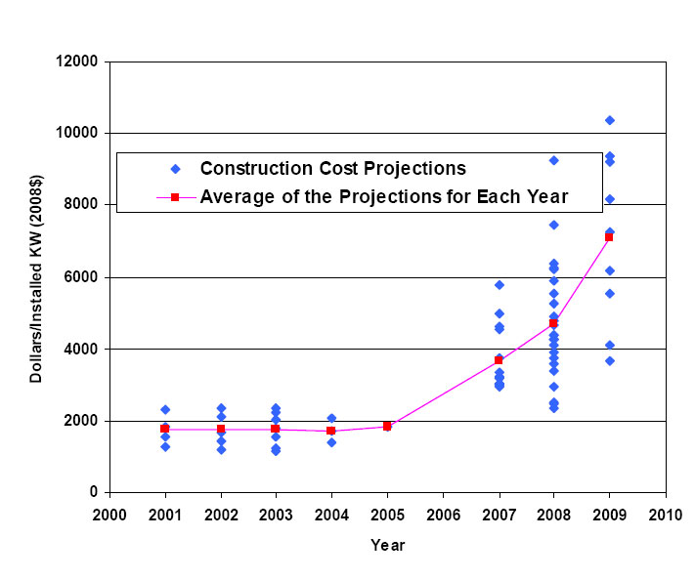
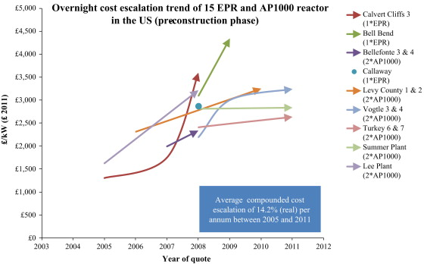
So far, Overnight reactor costs have only climbed
Overnight cost in 2017 £6,666 per kilowatt Vogtle 3 and 4 ($10,000)

Slide 34
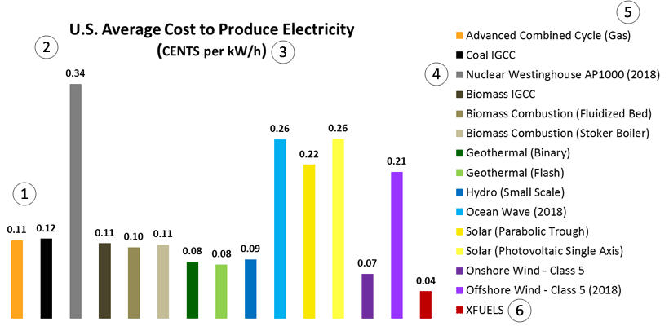
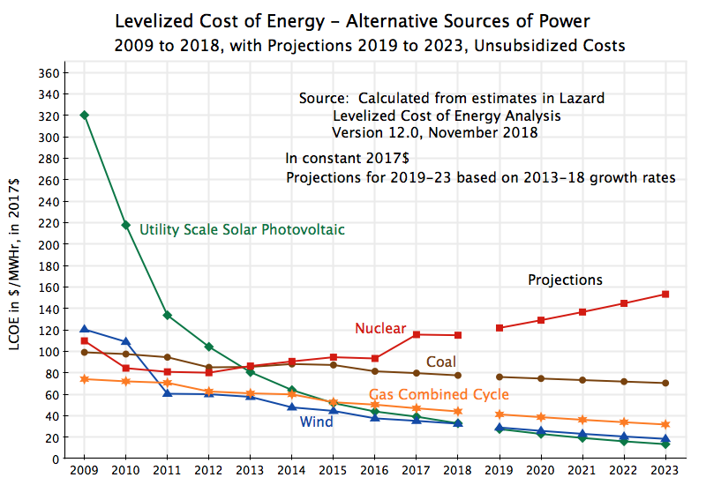
levelized costs are rising as well

Slide 35
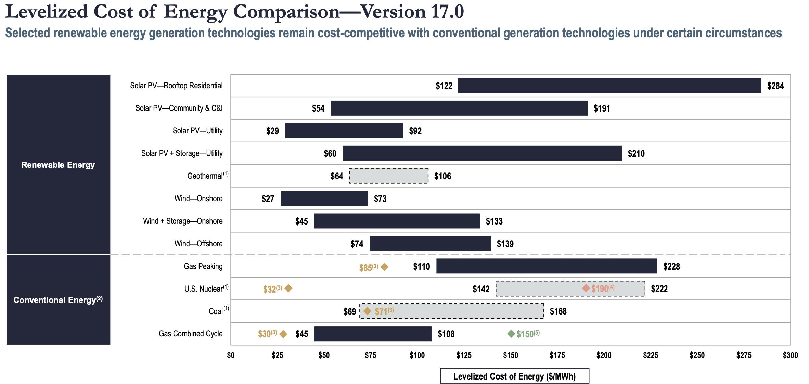
TODAY, LARGE REACTOR BUILDS CAN’T COMPETE ECONOMICALLY WITH NONNUCLEAR ALTERNATIVES - 2024

Slide 36
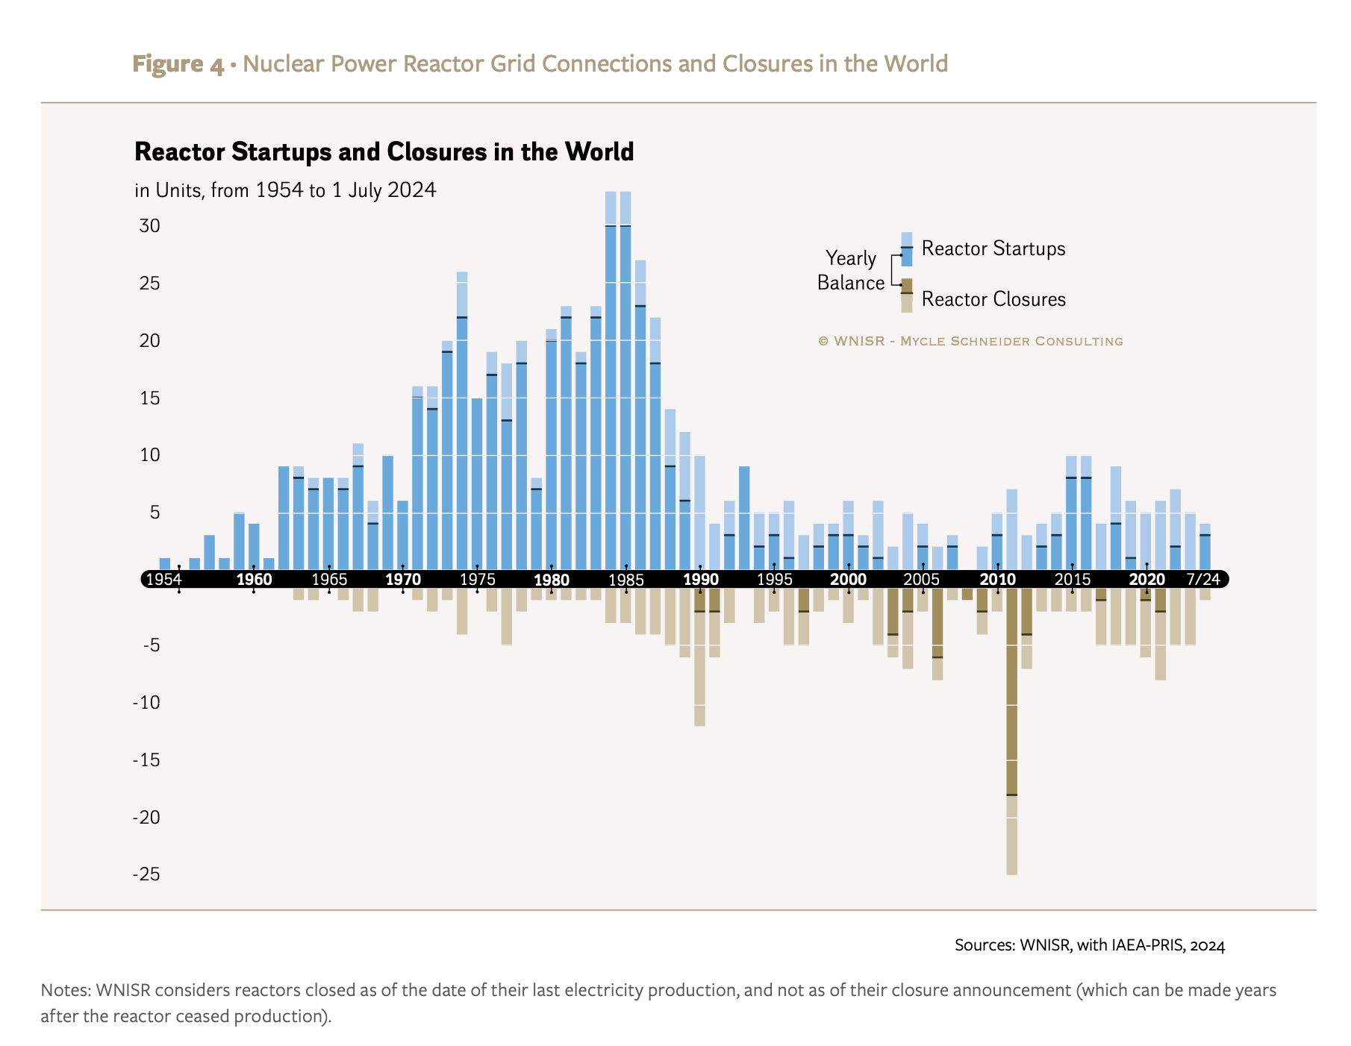
This Has Discouraged New Large Reactor Builds

Slide 37
The Economic Case for Small Reactors, Advanced and Modular
Cost less (individually projected to cost $1 - $3 billion, not $14 billion)
Should fit more readily on the grid and can be sited nearer customers to afford district or commercial heating
Many may not need to be refueled frequently
Don’t emit carbon

Slide 38
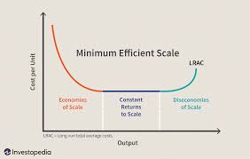
With Bigger reactors, Capital Costs of Producing Electricity Should Decline. with small reactors, electricity prices decline if reactors are cheap

Slide 39
The economic case against small and advanced modular reactors
Small reactors may have difficulty achieving scale of economies (promoters presume mass production will overcome high capital cost/installed KW). History suggests otherwise.
Most proposed small reactors rely on new fuels that require significant government development and support
Most “advanced” small reactors toy with historically costly fast reactor technologies—use plutonium or HEU or at least 20%
There are cheaper, quicker ways to reduce greenhouse gases
Some of the proposed designs are not so small

Slide 40
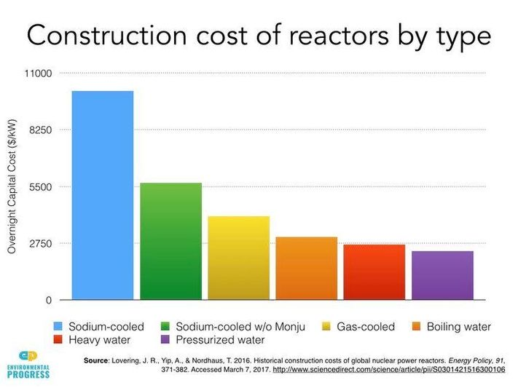
Yet, Historically “Advanced” Fast Reactors Have Proved the Most Costly to Build

Slide 41
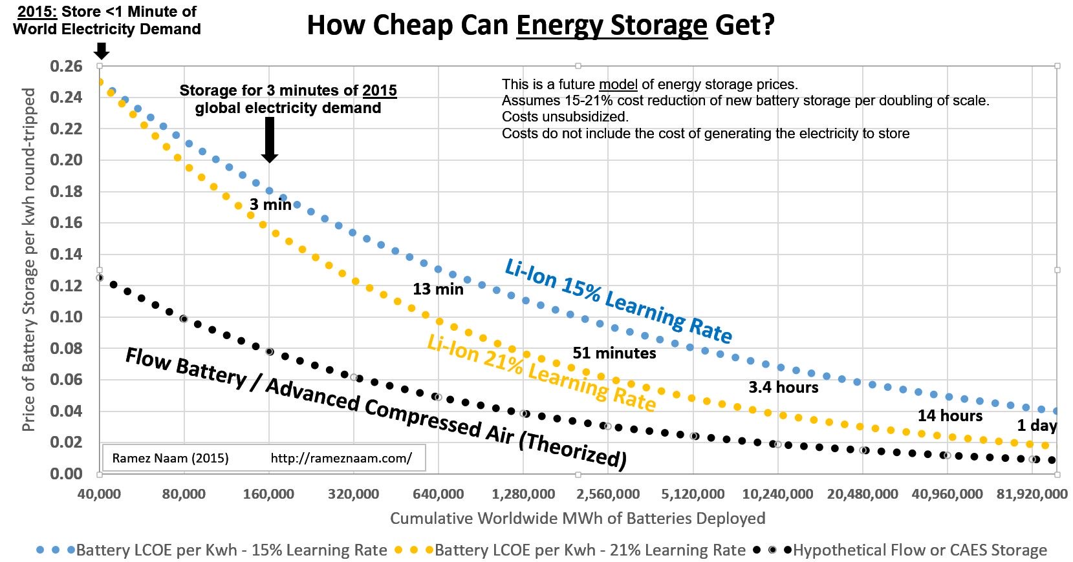
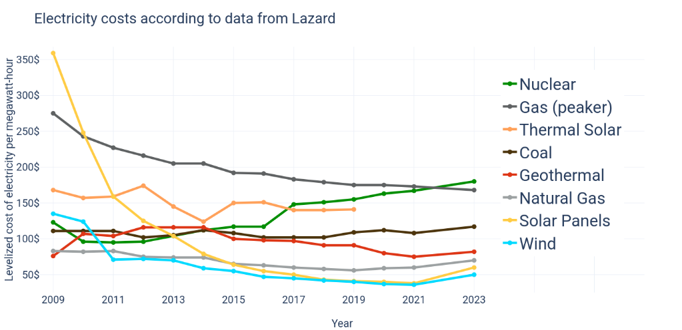
Nonnuclear Economic Competition Is Projected to Get Stiffer
https://en.wikipedia.org/wiki/Levelized_cost_of_electricity
2021 there were 56 gigawatt hours of grid battery storage deployed worldwide
https://about.bnef.com/blog/global-energy-storage-market-to-grow-15-fold-by-2030/

Slide 42
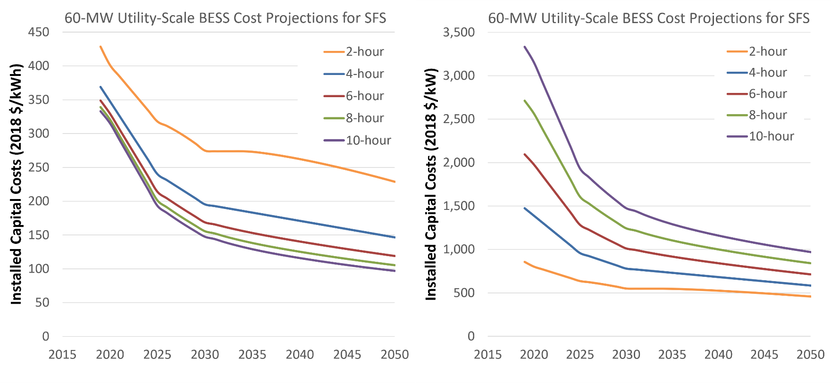
Grid battery storage is coming down as well
https://atb.nrel.gov/electricity/2022/utility-scale_battery_storage

Slide 43
New energy technology developments reinforce move away from nuclear and coal

Slide 44
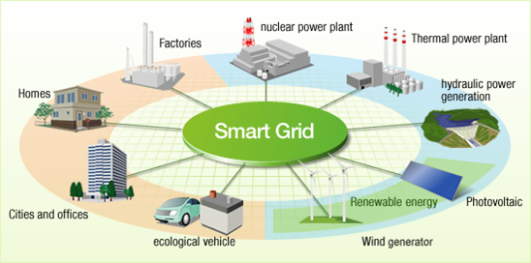
Smart grids balance a wide # of electrical sources & reduce base load requirements

Slide 45
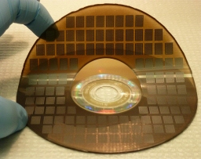
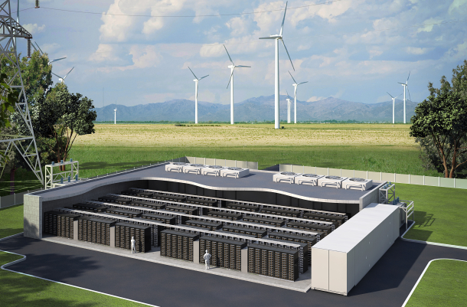


Technologies for smart grids
Super Capacitors, Switches, Batteries, Direct Current Systems
MICRO
SUPERCAPACITOR
WIND FARM
BATTERY BANK
SMART
MONITOR
High Voltage Direct Current Grid

Slide 46

Technologies for Smart grids also can be used in distributed systems

Slide 47

Distributed electrical systems would make the grid a backup system

Slide 48

The grid Management challenge renewables present

Slide 49


Lithium discoveries in the united States

Slide 50




Lithium-Ion Giga-battery factories
planned Brandenburg
Netherlands
Nevada
https://merics.org/en/analysis/chinas-battery-industry-powering-global-competition

Slide 51


Other kinds of batteries
Flow battery, California, 2 megawatt 8 megawatt hours
Utah plans 1 gigawatt

Slide 52


More Batteries
Pumped storage
Concentrated solar plant, Spain

Slide 53

Battery storage is increasing natural gas’s competitive edge

Slide 54
Renewables are becoming more attractive in the middle east

Slide 55

The middle east is rich in renewable energy potential

Slide 56


Concentrated Solar Power Costs:
Now Well Below Nuclear

Slide 57
Saudi Arabia’s Best Bet is Not Nuclear
Source: Qamar research

Slide 58

Uranium: Plentiful and Cheap ~$65.29/pound, 08/2024
https://world-nuclear.org/information-library/nuclear-fuel-cycle/uranium-resources/uranium-markets.aspx
https://ycharts.com/indicators/uranium_spot_price#:~:text=Uranium%20Spot%20Price%20is%20at,9.16%25%20from%20one%20year%20ago.

Slide 59

Enrichment Services: Climbing on speculation
($106.97/SWU 10/24 Spot)
https://seekingalpha.com/article/4556160-centrus-energy-reiterating-bullish-thesis

Slide 60
Future Non-Economic variables of interest

Slide 61

Energy Intensity of GDP is declining

Slide 62

Current global warming models assume median population growth

Slide 63

It’s unclear if population will decline or rise after 2040

Slide 64

Fertility has declined with Education
https://ourworldindata.org/grapher/womens-educational-attainment-vs-fertility

Slide 65

We still waste more than half the energy we produce

Slide 66
If you were to invest in electricity production, and wanted a positive return on your investment in less than 5 years, which would you pick?
- Nuclear
- gas
- renewables
- interconnection and switching technology
- battery storage

Slide 67
Additional Slides

Slide 68


Slide 69


Slide 70
Theoretically, As Reactors Get Bigger, the Capital Costs of Producing Electricity Should Decline
The larger the reactor, the more electricity it produces. Making them bigger was supposed to reduce the cost of an installed kilowatt hour

Slide 71

Today, Large Reactor Builds Can’t Compete Economically with Nonnuclear Alternatives

Slide 72

This Has Discouraged New Reactor Builds

Slide 73



As Reactors Grew Larger, Economics Recommended that Containment Requirements Be Loosened
Fuel Failures and Core Meltdowns Were Presumed Unlikely
Hallam Nuclear Power Plant, 240 MWe, 1962
Three Mile Island, 2x 812 MWe

Slide 74

And Even with More Lax Containment Requirements, Reactor Complexity, Construction Costs Still Grew

Slide 75

Increased Costs Have Hardly Encouraged Nuclear Industry to Cover Full Liabilities, which, in Turn, Discourages Industry from Making Safety Investments
Fukushima: $200 b to >$700 b.
Chernobyl: >$200 b
Three Mile Island ~$1.78 b

Slide 76


The Safety Case for Small Reactors, Advanced and Modular
Small reactors produce less radiation and waste per reactor
Some designs can be passively cooled (without pumps), “self-regulating”
Can incorporate most nuclear components within a single pressurized vessel
Can be built underground

Slide 77






Unkind History: Previous Small Reactors Proved Too Small to Compete Economically
Fermi 1, 69 MWe
Elk River, 22 MWe
LaCrosse, 50 MWe
Fort St. Vrain, 185 MWe
Piqua, Ohio, 12 MWe
Punta Higuera, Puerto Rico, 17 MWe

Slide 78






DOE Now Wants Small Reactors to Go Fast
Traveling Wave Reactor
Toshiba 4s Reactor
SLIMM
Molten Chloride Fast Reactor
Energy Multiplier Module
PRISM reactor

Slide 79
Yet, Historically Fast Reactors Have Proved the Most Costly to Build

Slide 80


To Help Out, DOE Plans to Spend Billions on Advanced Nuclear Fuels in Support of SMRs
American Centrifuge Plant, Pinkerton, OH or DOE alternative, $10 B?
Versatile Test Reactor, $3-6 B

Slide 81
The Economic Competition Is Projected to Get Stiffer
2018 there were 12 gigawatt hours of grid battery storage deployed worldwide

Slide 82



Industry Counting on Exporting Small Reactors to the Middle East
SMART Reactor, Saudi Arabia
NuScale Reactor, Jordan
Jordan

Slide 83
What nuclear activities make money
Existing Uranium enrichment
Nuclear fuel fabrication ~ $23 billion
Production of industrial, agricultural, and medical isotopes ~ $30 billion

Slide 84





Safety is a much bigger issue
Global City Populations
Low & High Nuclear Growth Scenarios

Slide 85
Sound nuclear safety methodology: What's currently lacking internationally
NRC argues
Risk = Probability x Consequence
(focuses on prompt deaths, exposure calculations, assumes evacuation success, manipulates calculations for "reactor years" between accidents).
Concludes probability is too low to question safety
Nuclear industry refuses to assume any risk whatsoever for off-site damage in the case of nuclear accidents

Slide 86
Uncertain energy futures: last half of the 19th century
Lighting: Whale oil, gas, candle, electricity
Heating: Oil, coal, gas, wood, electricity
Locomotion: Steam, electricity, gasoline, diesel
Electricity: AC, DC

Slide 87
Uncertain energy futures: 1950
Lighting: Electricity (centrally generated, grid distributed)
Heating: Gas, electric, fuel oil
Locomotion: Gasoline, diesel
Electricity: AC, Coal, oil fueled, hydro

Slide 88
Uncertain energy futures: Next Half century
Lighting: Incandescent, fluorescent, LED
Heating: Electricity, gas, biomass, solar, geothermal
Locomotion: Electric vehicles, gasoline, fuel cell, diesel
Electricity: AC, DC, distributed, central, flow batteries, fuel cells, smart switching, photovoltaics, small reactors

Slide 89
Electrical grid resilience basics

Slide 90

Distribution of energy interruptions

Slide 91

US energy interruptions: 2012-2016

Slide 92




Causes of energy interruptions
Trees/Weather
Vegetation
Ice Storms
Equipment Failure

Slide 93




Squirrels, other animals are also a problem
Power outages caused by animals since 1987
Confirmed power outages caused by Squirrels in 2017
Source: https://cybersquirrel1.com/

Slide 94




What can be done to reduce outages?
Upgrade local electrical repair teams
Go off-grid
Clear trees and vegetation
Create a transformer reserve for quick replacement

Slide 95

What interruptions government officials focus on is a function of their authority

Slide 96

Gas distribution is growing but still disconnected

Slide 97

Levelized Energy cost Comparisons after Fukushima
Source: Lazard “Levelized Cost of Energy Analysis - Version 10.0”

Slide 98



Slide 99

An Alternative: An electric connected asia

Slide 100


US Carbon abatement: coal retirements and gas substitutes
https://www.eia.gov/todayinenergy/detail.php?id=7290 and
https://www.eia.gov/todayinenergy/images/2016.05.19/main.png

Slide 101

US carbon emissions flat to declining
https://www.mprnews.org/amp/story/2020/04/08/us-greenhouse-gas-emissions-may-fall-75percent-in-2020

Slide 102


“Beijing to shut all major coal power plants to cut pollution”–Bloomberg News, March 23, 2015
China aims to shut 8.7 GW of coal power by year-end – regulator – Reuters, September 29, 2019 (1,000 GWe of coal power still operating today)

Slide 103


After Covid, Beijing is burning lots of coal
https://www.statista.com/statistics/265491/chinese-coal-consumption-in-oil-equivalent/
https://en.wikipedia.org/wiki/Coal_in_China

Slide 104

China projected to build 270 GW of new coal – burning generators by 2025

Slide 105

Profitability outlook for all us nuclear plants, 2017-2019

Slide 106

US Large Reactor growth likely to be negative
https://www.nytimes.com/interactive/2018/06/13/climate/coal-nuclear-bailout.html

Slide 107



Nuclear retirements until recently, were Clearly outstripping construction in Europe

Slide 108

This was also happening in Japan and South Korea
Number of Nuclear Reactors in
South Korea, Current and Projected https://en.yna.co.kr/view/AEN20220310003900320#:~:text=South%20Korea%20now%20has%20a,total%20power%20generation%20by%202030
In 2021, ROK nuclear = 27.4%
New plan for 2030 ~ 30%
Japan ~ 20% by 2030

Slide 109
Nuclear growth in China, slowing down
https://asia.nikkei.com/Business/Energy/China-greenlights-6-new-nuclear-reactors-in-shift-away-from-coal

Slide 110

Allam Cycle Generator: Economic, Zero Emissions at 4-5 cents/KWh?

Slide 111
Unkind History: earlier Small Reactors were Too Small and unreliable to compete
Fermi 1, 69 MWe
Elk River, 22 MWe
LaCrosse, 50 MWe
Fort St. Vrain, 185 MWe
Piqua, Ohio, 12 MWe
Punta Higuera, Puerto Rico, 17 MWe

Slide 112

More Unkind History: Gen III Reactors Also Were Modular
Two ACP100 modular reactors have been given construction go ahead Brian Wang | November 17, 2011 (projected to come online 2013 but didn’t)

Slide 113
DOE NOW WANTS SMALL REACTORS TO BE “ADVANCED”-- FAST
Traveling Wave Reactor
Toshiba 4s Reactor
SLIMM
Molten Chloride Fast Reactor
Energy Multiplier Module
PRISM reactor

Slide 114
To Help Out, DOE Plans to Spend Billions on Advanced Nuclear Fuels in Support of SMRs
American Centrifuge Plant, Pinkerton, OH or DOE alternative, $10 B?
Versatile Test Reactor, $3-6 B

