Slide 1
NUCLEAR ENERGY BASICS,
PART 2:
REACTORS AND NUCLEAR FUEL MAKING
A presentation by
Henry Sokolski
Executive Director
Nonproliferation Policy Education Center
www.npolicy.org
© Nonproliferation Policy Education Center

Slide 2
Questions to BE Addressed:
What are the basic stages of once-through uranium based fuel cycles?
What are the most popular methods of enriching uranium?
What are the different types of nuclear reactors and how proliferation prone is each?
What can be done with spent reactor nuclear fuel?

Slide 3
Short Answers
There are six stages: Uranium mining and milling, conversion to uranium hexafluoride (UF₆), uranium enrichment, fuel fabrication, generating nuclear electricity, spent fuel storage.
Centrifuges and gaseous diffusion
All types of reactors can make nuclear explosive plutonium– light water and heavy water reactors, gas cooled and graphite reactors, RMBK and fast reactors
Spent fuel can be recycled or not. In either case, there will be considerable waste that must be stored above or under ground.

Slide 4
0. Nuclear Fuel Cycle Basics

Slide 5
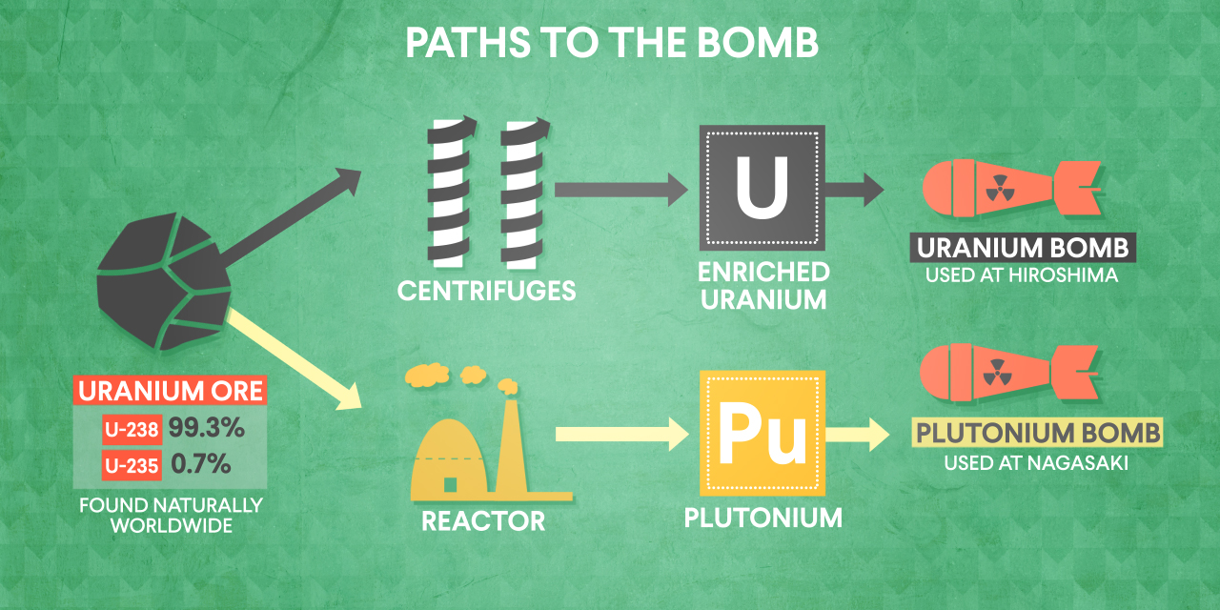
There are two Major Paths to the Bomb

Slide 6
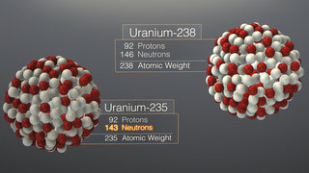
U238 & U235: two important uranium isotopes
U238
Has 146 neutrons
constitutes 99.3% of uranium in nature
Is not prone to fission
U235
Has 143 neutrons
Constitutes .7% of uranium found in nature
Is prone to fission

Slide 7
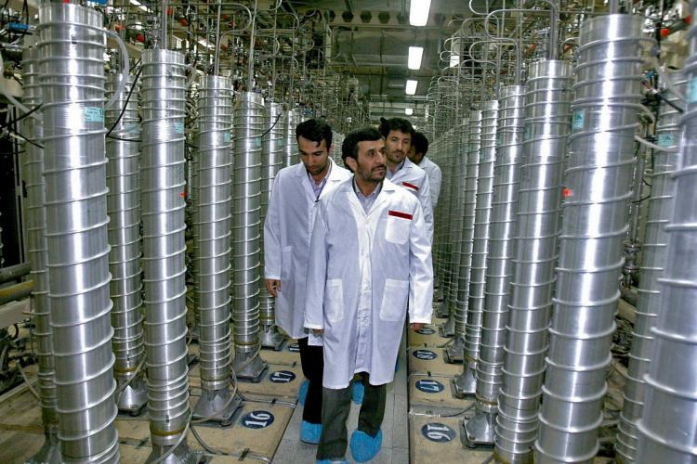
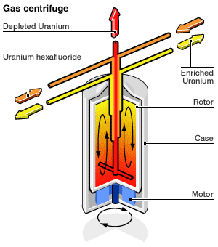
Uranium centrifuge enrichment separates the heavy uranium from the light uranium

Slide 8
There are two Major Paths to the Bomb

Slide 9
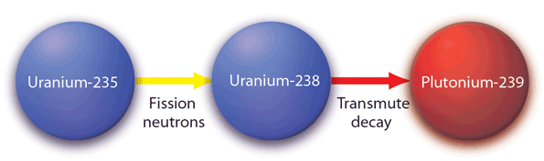
Uranium Transmutes to Plutonium in a Reactor

Slide 10
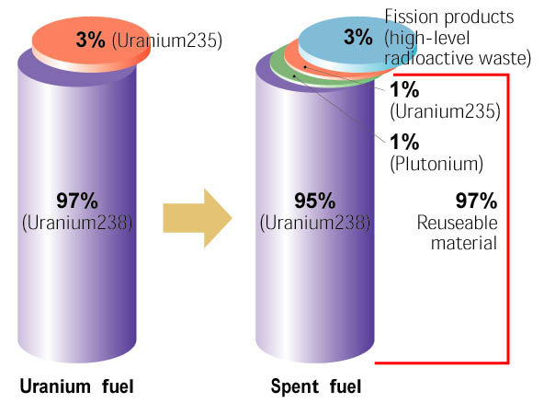
Spent Reactor Fuel Contains Plutonium That Can Be Chemically Stripped Out (Reprocessed)

Slide 11
1. What are the basic stages of once-through uranium based fuel cycles?

Slide 12
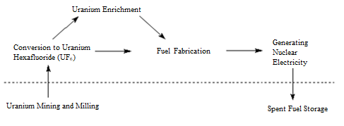
Once-Through Fuel Cycle doesn’t reprocess spent fuel
FIGURE 1

Slide 13
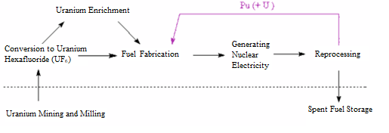
Closed Plutonium-Based Fuel Cycle requires reprocessing
FIGURE 2

Slide 14
Basic stages of once-through uranium-based fuel cycles
Uranium Mining and Milling
Conversion to Uranium Hexafluoride (UF₆)
Uranium Enrichment
Fuel Fabrication
Generating Nuclear Electricity
Spent Fuel Storage

Slide 15
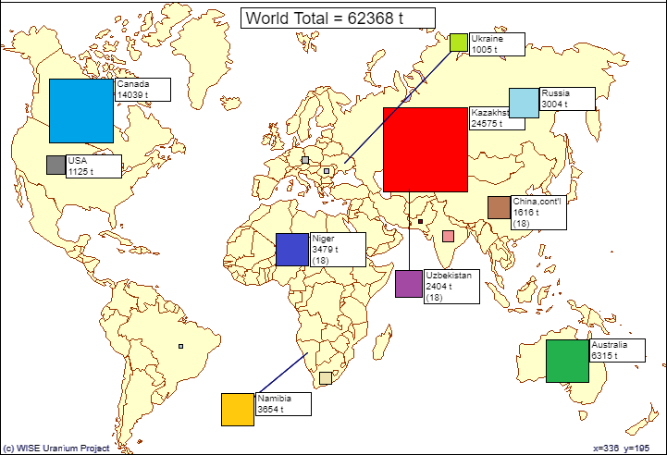
Major uranium producers 2016
FIGURE 3

Slide 16
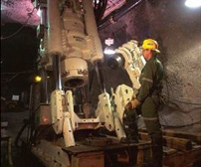
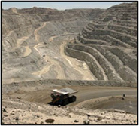
Conventional uranium Mining
Underground
Open Pit

Slide 17
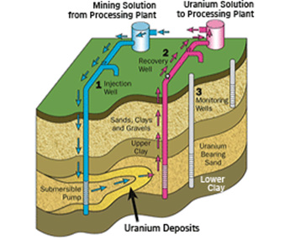
In Situ Recovery mining method
1. Injection Wells
2. Recovery Wells
3. Monitoring Wells

Slide 18
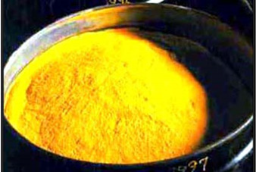
yellowcake

Slide 19
Basic stages of once-through uranium-based fuel cycles
Uranium Mining and Milling
Conversion to Uranium Hexafluoride (UF₆)
Uranium Enrichment
Fuel Fabrication
Generating Nuclear Electricity
Spent Fuel Storage

Slide 20
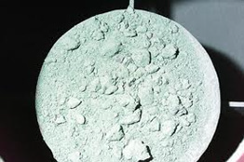
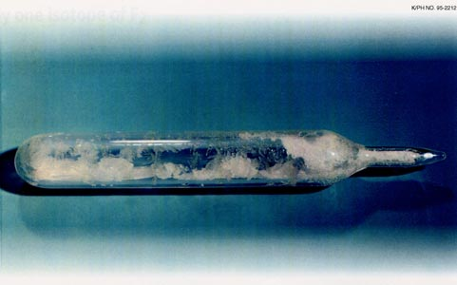
UF₄ (Green Salt) and uf₆ (Uranium hexafluoride)

Slide 21
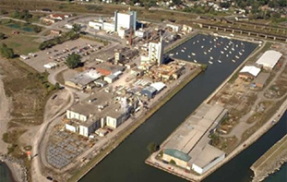
Hexafluoride Conversion Facility– large & rare
Port Hope in Ontario, Canada

Slide 22
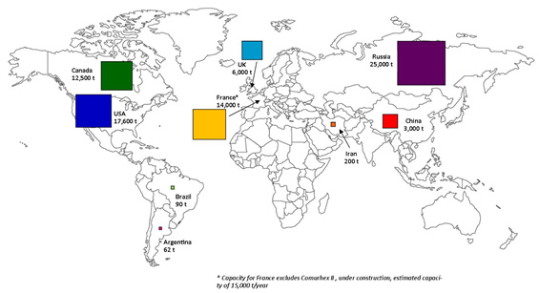
Major hexafluoride uf₆ producers
[t U/year] metric tons uranium/year

Slide 23
2. What are the most popular methods of enriching uranium?

Slide 24
Most Countries that enrich uranium Use centrifuges
Gaseous Diffusion: Argentina
Centrifuge: Brazil, U.S.-URENCO, Holland, France, UK, Germany, Russia, China, Japan, Iran, India, Pakistan, North Korea

Slide 25
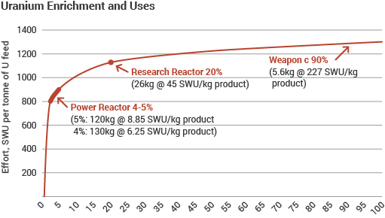
The effort needed to enrich U to 3-5% is half of what is needed to enrich to Weapons-Grade u
Separative Work Units Needed to Enrich Uranium to Power, Research, and Weapons grades

Slide 26
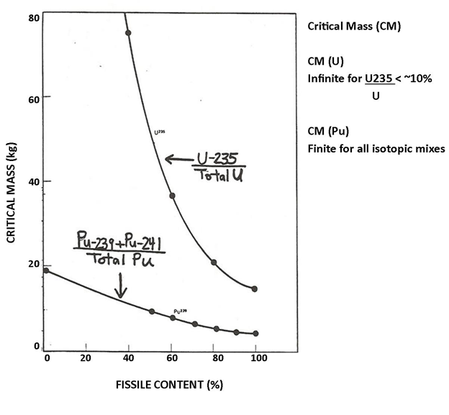
Critical Masses of Uranium & Plutonium as a Function of Isotopic Mix

Slide 27
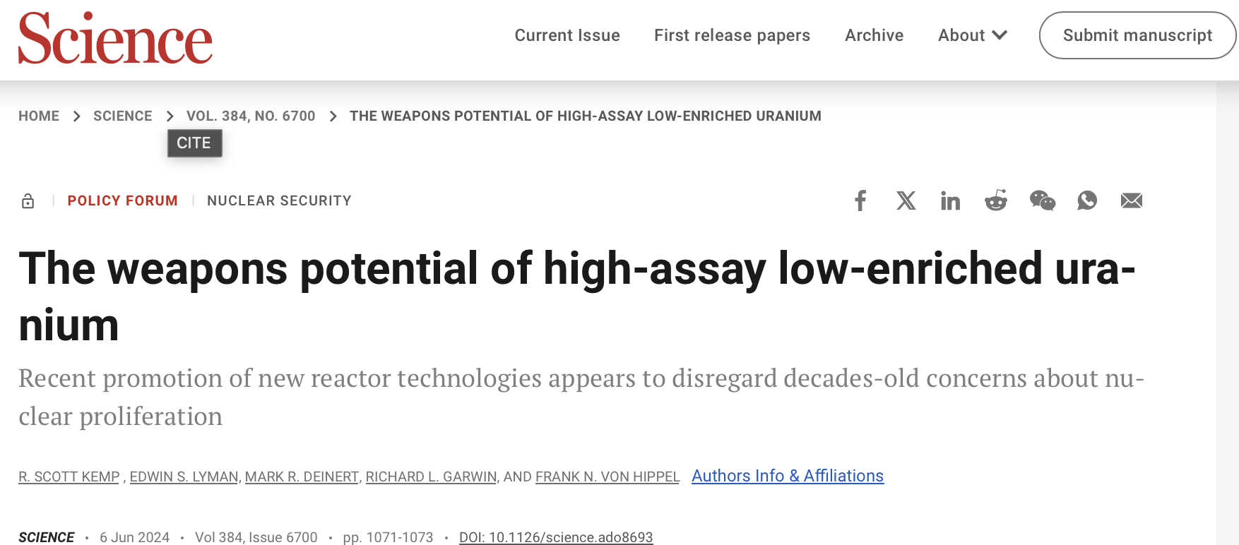
The weapons potential of high-assay low-enriched uranium

Slide 28
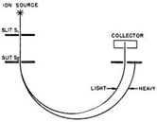
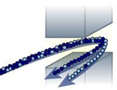
Electric magnetic isotope separation (emis) exploits different weights of u235 and u238

Slide 29
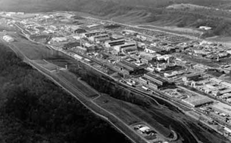
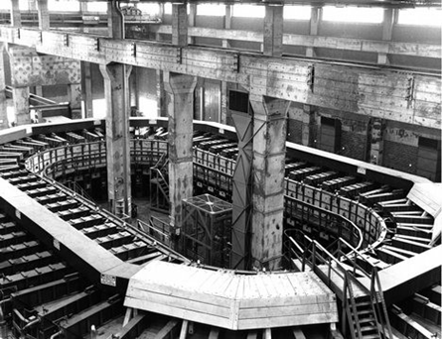
The Y-12 Plant at Oak Ridge, Tennessee used emis
The Y-12 Plant
Alpha Track Calutron at the Y-12 Plant at Oak Ridge, Tennessee

Slide 30
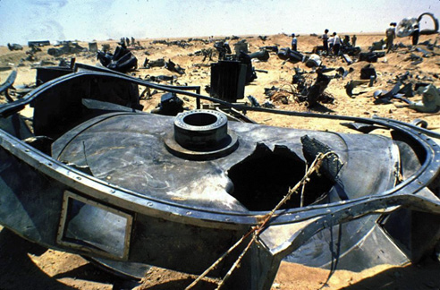
EMIS “Calutron” was Discovered in Iraq in 1991

Slide 31
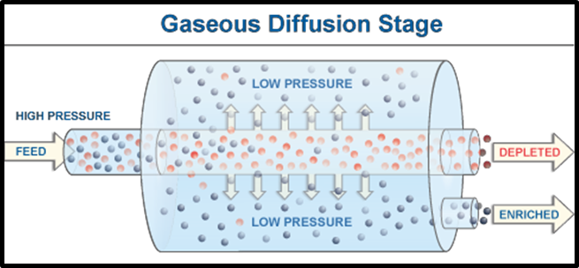
Gaseous Diffusion also exploits different weights of u238 & u235

Slide 32
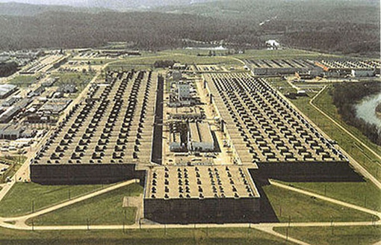
1st Gaseous Diffusion Plant was one of the world’s largest construction projects
K-25 Plant, Oak Ridge, Tennessee, The first gaseous diffusion plant

Slide 33
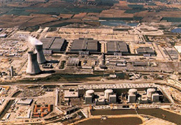
French Gaseous Diffusion Plant is powered by 4 nuclear reactors
French gaseous diffusion plant powered by nearly 4 gigawatts electrical, four nuclear power reactors.

Slide 34
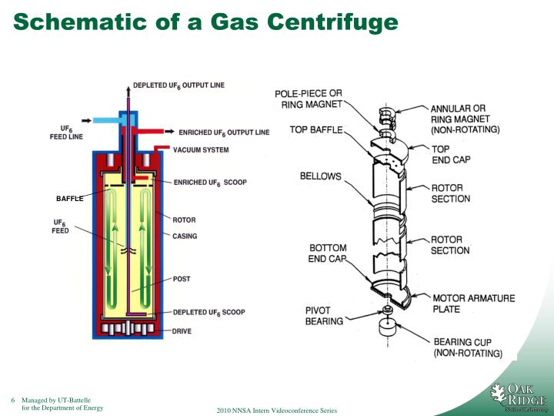
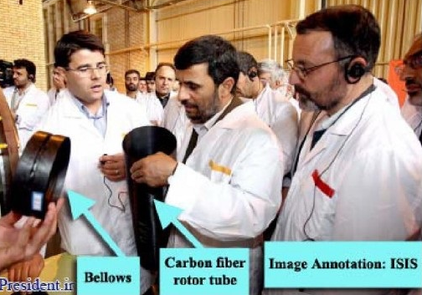
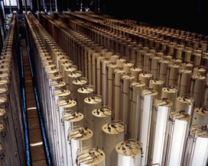
Gas centrifuge Components

Slide 35
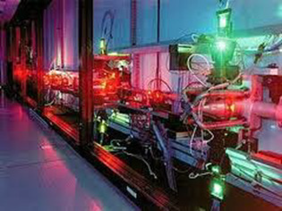
The AVLIS (atomic vapor laser isotope separation) process

Slide 36
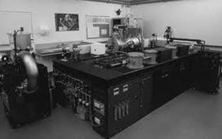
Separation of Isotopes by Laser Excitation (SILEX): smaller, cheaper still

Slide 37
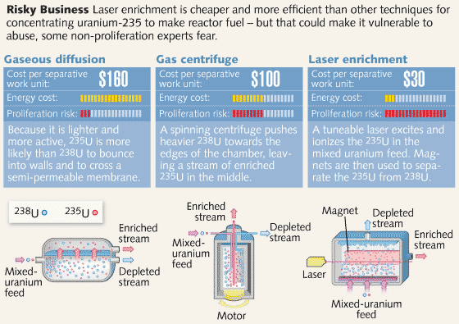
Price and Proliferation Risk Comparison of Diffusion, Centrifuge, and SILEX Enrichment

Slide 38
Basic stages of once-through uranium-based fuel cycles
Uranium Mining and Milling
Conversion to Uranium Hexafluoride (UF₆)
Uranium Enrichment
Fuel Fabrication
Generating Nuclear Electricity
Spent Fuel Storage

Slide 39
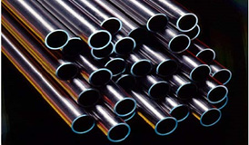
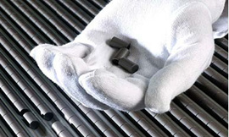
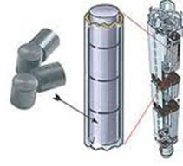
Fuel fabrication
Zirconium Alloy (or Similar)
Tubes for Cladding
Ceramic Uranium
Dioxide Pellets
Left: Individual fuel pellets.
Center: Pellets are assembled into a fuel rod
Right: Fuel rods are bundled together in a fuel assembly

Slide 40
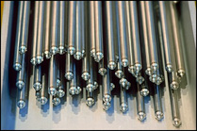
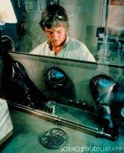
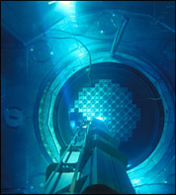
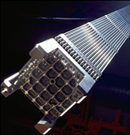
Fuel rod and fuel assembly process
Completed Fuel Rods
A technician arranges fuel pellets in a trough before sliding the cladding over them.
Fuel Assemblies in Reactor Core
Fuel Rod Assembly

Slide 41
3. What are the different types of nuclear reactors and how proliferation prone is each?

Slide 42
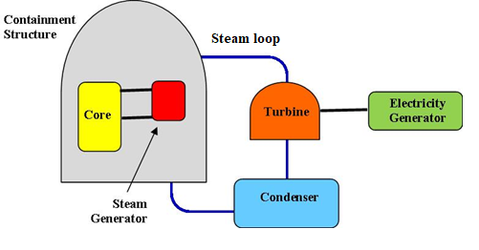
Simplified Schematic of a Nuclear Reactor

Slide 43
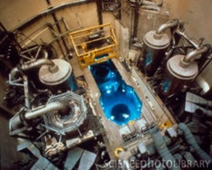
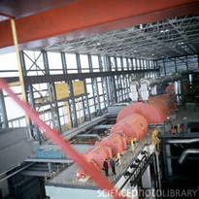
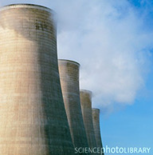
biggest Nuclear power plant components
Steam Turbines
Nuclear core and steam generators (during refueling)
Cooling Towers

Slide 44
Major TYPES OF NUCLEAR REACTORs
Early Graphite Reactors
Magnox Reactor
Heavy Water Reactor (HWR)
Liquid-Metal Fast Breeder Reactor (LMFBR)
Light Water Reactors (LWR)—Pressurized (PWR) and Boiling (BWR)
RBMK
High-temperature Gas Cooled Reactor (HTGR)

Slide 45
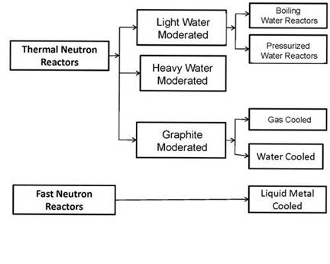
Reactor Species or groups

Slide 46
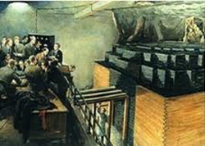
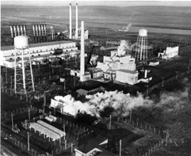
First reactors: Graphite moderated
Chicago Pile-1
B Reactor

Slide 47
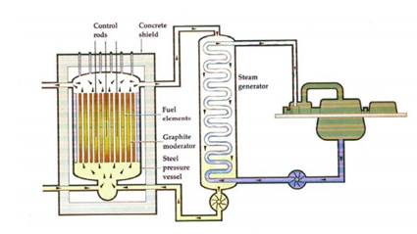
Magnox Reactor: UK dual-use graphite design
Fuel | Natural Uranium
Moderator | Graphite
Coolant | Air
Refueling | On-load

Slide 48
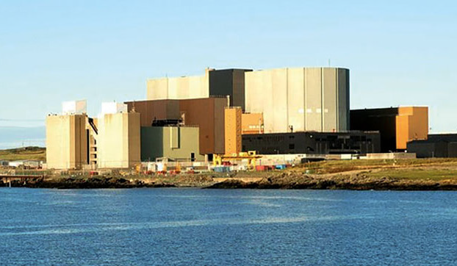
Wylfa MAGNOX Nuclear Plant, UK

Slide 49

Yongbyon reactor: a magnox design

Slide 50


Atomic Structure of heavy water D₂O vs H₂O
Frozen D2O (at right) sinks in light
water while frozen H2O floats

Slide 51

Heavy Water Production
The Arak heavy water project located 120 miles southwest of Tehran
Whiteshell, UK

Slide 52

Heavy Water Reactors
1. Fuel bundle
2. Calandria (reactor core)
3. Adjustor rods
4. Heavy water pressure reservoir
5. Steam generator
6. Light water pump
7. Heavy water pump
8. Fueling machines
9. Heavy water moderator
10. Pressure tube
11. Steam going to steam turbine
12. Cold water returning from turbine
13. Containment building of reinforced concrete

Slide 53

Heavy Water Reactors Continued
Fuel | Natural uranium clad in zircaloy
Moderator | Heavy Water
Coolant | Heavy Water
Refueling | On-load

Slide 54

On-Line Refueling—HWRs
CANDU Reactor

Slide 55
Countries who operate or used to operate HWRs
Countries that operate HWRs: India, Argentina, Pakistan, Romania, Israel, China, and South Korea, Iran, Canada
Countries that used to operate HWRs: Germany, Sweden, Taiwan, and the United States, Russia, France

Slide 56

IR-40 Heavy Water Reactor Near Arak, Iran

Slide 57

Some Heavy water transmutes into tritium in hwrs. This tritium must be extracted for safety reasons but can also be used for h-bombs
Wosong Tritium Removal Facility: ROK Has Produced and Stockpiled Enough Tritium (4 kgs.) to Boost 1,000 Weapons

Slide 58

CONVENTIONAL REACTORS EXPLOIT THERMAL REACTIONS, FAST REACTORS EXPLOIT FAST ONES
Fast Neutron Reactions
Thermal Neutron Reactions
Popular neutron moderators include light water, heavy water, and graphite
Neptunium
Weapons-grade plutonium
Plutonium

Slide 59


Liquid Metal Fast Breeder Reactor (LMFBR): first reactor to produce electricity
Sodium-Cooled Fast Reactor
Fuel | Pu or MOX- clad in stainless steel
Moderator | None
Coolant | Liquid sodium
Refueling | Off-load

Slide 60


Liquid Metal Fast Breeder Reactors also have been used to make bomb plutonium
India’s prototype fast breeder reactor under construction at Kalpakkam
Phénix, prototype fast breeder reactor in Marcoule, France – shut down in 2009

Slide 61
fast breeder reactors are off-line fueled

Slide 62
Fast Breeder reactor states
Countries that operate FBRs: China, Russia
Countries constructing FBRs: India, China
Countries with plans for FBRs, but not currently operating: Japan, South Korea, France, U.S.
Countries that have had FBRs in the past, but aren’t currently operating: U.S., France, U.K., Germany, Japan

Slide 63





COMMERCIAL FAST BREEDERS: FAILED & ABANDONED
Superphenix, France, used to make bombs
Monju, Japan
Kalkar, Germany
Dounrey, UK
Enrico Fermi, Detroit

Slide 64





REMAINING BREEDERS: QUESTIONABLE
Fast breeder reactor, India. To be used to make weapons
Fast breeder reactor, Russia. Over budget, completion delayed, tech exported to PRC
Experimental 20 MWe fast breeder reactor, China
First 600 MWe fast breeder reactor, China
Second 600 MWe fast breeder reactor, China

Slide 65


Light-Water Reactor (PWR)
Typical Pressurized Water Reactor
Fuel | LEU
Moderator | Light Water
Coolant | Light Water
Refueling | Off-load

Slide 66


First Light water reactor was designed for submarines

Slide 67

Three Mile Island Nuclear Power Plant, U.S.

Slide 68

Light-Water Reactor (BWR)
Fuel | LEU
Moderator | Light Water
Coolant | Light Water
Refueling | Off-load
Typical Boiling-Water Reactor

Slide 69

Fukushima Daiichi Nuclear Power Plant, Japan

Slide 70

LWRs are off-load fueled
LWR refueling

Slide 71

RBMK (Reactor Bolshoy Moshchnosty Kanalny)
Fuel | LEU clad in zircaloy
Moderator | Graphite
Coolant | Light Water
Refueling | On-line

Slide 72

Chernobyl Nuclear Power Plant, Ukraine

Slide 73

High Temperature Gas Cooled Reactor
Fuel | Uranium clad in a graphite matrix
Moderator | Graphite
Coolant | Helium
Refueling | Off-load

Slide 74

Fort St. Vrain Power Station was a one-off
Fort St. Vrain Power Station, HTGR. It operated from 1976 to 1989.

Slide 75

On-Line Refueling—HTGC (pebble bed)
Under construction in China

Slide 76

Generation iv Reactors

Slide 77

Small Modular LWRs

Slide 78







Fast Small Modular Reactor

Slide 79


NuScale Reactor

Slide 80
Summary of reactor characteristics by type
Type of Reactor | Magnox Reactor | High Temperature Gas- Cooled Reactor (HTGR) | Pressurized Water Reactor (PWR) | Boiling Water Reactor (BWR) | Heavy Water Reactor (CANDU) | Liquid Metal Fast Breeder Reactor (LMFBR)
Name of Example | Chapelcross (UK) | Fort St. Vrain (USA) | Zion (USA) | Browne Ferry 2 (USA) | Pickering (Canada) | Phenix (France)
Heat Output | 840 MWt | 842 MWt | 3250 MWt | 3293 MWt | 1744 MWt | 563 MWt
Electrical Output | 275 MWe | 330 MWe | 1050 MWe | 1065 MWe | 308 MWe | 233 MWe
Fuel | Natural Uranium Metal clad in Magnox alloy | Uranium carbide particles, enriched, coated in graphite matrix | Uranium oxide, 3% enriched, clad in Zirconium | Uranium oxide, 2.2% enriched, clad in zircaloy | Natural uranium oxide clad in zircaloy | Mixed uranium and plutonium oxide (MOX), 20 -27% enrichment, clad in stainless steel
Moderator | Graphite | Graphite | Light water | Light water | Heavy Water | None
Coolant | Carbon dioxide gas | Helium | Light water | Light water | Heavy water | Liquid sodium
Refueling | On-load | Off-load | Off-load | Off-load | On-load | Off-load

Slide 81
Plutonium production by reactor type
Fissile Material Produced by a 1,000 MWe Reactor Operating at 70% Load Factor for One Year
Reactor Type | Initial Fuel (Enrichment) | Produced Pu (kg)
Light-Water Reactor | U²³⁵ (3%) | 175*
High Temperature Gas-Cooled Reactor | U²³⁵ (93%) | 29 (plus 64kg U²³⁵)
Canadian Deuterium-Uranium (CANDU) | U (natural) | 360
Fast Breeder Reactor | MOX | 300
* For a LWR that has been operating for over 36 months. Note that low-enriched reactors produce more plutonium than high enriched reactors (the fast breeder reactor uses plutonium as fuel, so much of what is produced will actually be reused as fuel). Again, production in a CANDU is the highest for a given power generation.

Slide 82
4. What can be done with spent reactor nuclear fuel?

Slide 83


Direct Disposal vs. Reprocessing

Slide 84

Commercial Reprocessing: a major undertaking
Rokkasho, Japan: over 20 billion spent, under construction since 1993

Slide 85






E. ASIA REPROCESSING: A FUTURE HEADACHE
PRC 50 tHM/yr Pilot plant: ~100 bombs worth of plutonium/yr
Possible PRC 800 tHM/yr EDF plant: ~1200+ bombs worth of pu/yr
Japan’s 800 tHM/yr plant: ~1,200+ bombs’ worth pu/yr, to open 2023
1st PRC 200 tHM/yr plant under construction to be on line by 2025
2nd PRC 200 tHM/yr reprocessing plant to be on line before 2030
ROK Experimental Pyroprocessing Facility, funding frozen

Slide 86

Ferguson Culler Design: Small, cheap, and quick

Slide 87
Reprocessing steps
Cooling
Head-end treatment
Separation/Extraction
Conversion of plutonium nitrate to plutonium oxide
Storage of radioactive wastes

Slide 88

cooling
Cooling Pool

Slide 89

Head-end treatment
Head-End Process

Slide 90


Separation/extraction
PUREX – Extraction Process
Windscale reprocessing towers

Slide 91

Reprocessing Pulse Column

Slide 92

Plutonium Uranium Extraction Plant at Hanford, Washington

Slide 93




Cooling Pools for Spent Fuel

Slide 94




Dry cask storage

Slide 95
Additional Slides

Slide 96
Critical Masses of Uranium & Plutonium as a Function of Isotopic Mix

Slide 97
Estimated Yields for Different Bomb Technologies Using LWR Pu

Slide 98
IAEA Safeguards guidelines
Direct Use Materials | Significant Quantity
Pu | 8 kg total element (containing less than 80% Pu-238)
U-233 | 8 kg total isotope
HEU | 25 kg contained U-235
Indirect Use Materials | Significant Quantity
LEU (U-235 <20%) | 75 kg contained U-235 (include natural and depleted U)
Thorium | 20 tons total element
Material | Timeliness Goal
Non-irradiated direct use (Pu in fresh fuel) | One Month
Irradiated direct use (e.g. Pu in spent fuel) | Three Months
Indirect use (e.g. LEU) | One Year

Slide 99


Basic IAEA Safeguards Methods
Example of IAEA Containment
Example of IAEA Surveillance

Slide 100

Schematic of Fukushima accident

Slide 101

Pyroprocessing
“South Korea also has advanced reprocessing technology. One professor of nuclear engineering said that "our capabilities when it comes to pyroprocessing, which involves reprocessing by using electolysis, are world-class.”
Chosun Ilbo, February 19, 2016
Planned ROK Pyroprocessing Plant

Slide 102

Wolsong Heavy Water Reactors
From the four CANDU-6 reactor cores and spent fuel at Wolsong, the RoK could recover 150 kg of lower-burnup fuel-grade plutonium (discharged during the first cycle after start-up—100 to 400 full-power days after start-up) and about 220 kg of higher burnup fuel-grade plutonium that could be used to fabricate more than 50 nuclear warheads with yields exceeding 20 kilotons based on pure fission solid core, levitated core or hollow core designs.

Slide 103
ROK Has Produced and Stockpiled Enough Tritium (4 kgs.) to Boost 1,000 Weapons
Wosong Tritium Removal Facility

Slide 104


Too Much Planned Japanese Plutonium for Any Peaceful Purpose
Rokkasho now may open Fall 2022

Slide 105

Enriching Uranium For What?
Rokkasho Uranium Enrichment Plant
Japan by 2022 could produce up to ~6,400 kg HEU/year or more than 500 bombs worth per year

Slide 106

Japan Can Master Boosting and More
The National Institute for Fusion Science (NIFS) in Toki
Japan Atomic Energy Agency’s (JAEA) Naka Fusion Institute, Ibaraki Prefecture
As its contribution to the International Thermonuclear Experimental Reactor (ITER) under construction in France, Japan will provide much of the high-tech components and will host an €1 billion materials testing facility – the International Fusion Materials Irradiation Facility (IFMIF).
Naka Fusion Institute, which includes the Tritium Processing Laboratory
National Institute of Fusion Research

Slide 107
Estimated Warhead Inventories: PRC, US, Russia
Source: http://www.tandfonline.com/doi/full/10.1080/00963402.2016.1264213 and http://www.tandfonline.com/doi/full/10.1080/00963402.2017.1290375

Slide 108

What if China Develops Many MIRVs?
According to the Belfer Center’s Hui Zhang, China’s limited fissile material stockpile means that the country does not have the ability to build significantly more warheads without restarting fissile material production.”
BAS March 24, 2015, Tong and Logan

Slide 109

What About Chinese Tactical Nuclear Weapons?
China developed and tested a neutron bomb in 1988 as a “technological reserve” - Liu Huaqiu, Senior Chinese Nuclear Scientist
Will China need tactical nuclear weapons to counter the U.S., its allies, or Russia?

Slide 110
Stocks of Highly Enriched Uranium
(18 tons)
± 4 uncertainty
(599 tons)
(679 tons)
Source: http://fissilematerials.org/library/gfmr13.pdf and http://fissilematerials.org/library/gfmr10.pdf

Slide 111

Projected PRC Enrichment Surpluses Beyond Power Requirements ~ 1,500 Bombs a Year
China’s has an estimated surplus of ~19,000 kg HEU
232 SWU required to make 1 kg HEU
Conservatively, in 2020, over 2,500 weapons worth for PRC, over 300 for Japan
120,000 SWU required to refuel 1-GWe reactor with LEU annually
(66 GWe PRC, 12.5 GWe Japan in 2020)
Hanzhong and Lanzhow

Slide 112



Projected Uranium Enrichment Surpluses in
East Asia
Projected enrichment
supply vs demand until 2035

Slide 113
Tons of Separated Plutonium
(1.8 tons assumed)
(87.6 tons)
(169.5-185.5 tons)
± 8 tons
uncertainty
Source: http://fissilematerials.org/library/gfmr13.pdf and http://fissilematerials.org/library/gfmr10.pdf

Slide 114

PRC’s Limited Plutonium Production Capacity Is the Bottleneck to Many More Weapons
PRC has only 2 plutonium production reactors
One is being dismantled
One hasn’t operated since the early 1990s
If restarted, the single reactor could produce roughly 300kg of plutonium a year, only enough to make roughly 75 plutonium triggers or bombs.
Jiuquan plutonium production reactor

Slide 115

PRC’s Most Immediate Alternative Plutonium Production Option: Its Heavy Water Reactors
Two Candu-6 reactors (600 MWe each) at Qinshan
Capable of producing ~650 kilograms of plutonium a year
Sufficient for roughly >100 bombs a year
Source: https://en.wikipedia.org/wiki/CANDU_reactor

Slide 116

1987: Reagan Administration Proposed Using WPSS LWR to Make Weapons Plutonium
Source: http://www.historylink.org/index.cfm?DisplayPage=output.cfm&File_Id=5482

Slide 117
HOW MUCH PLUTONIUM COULD A 1 GWE LWR GENERATE/YEAR?
4 kg weapons-grade Pu assumed per bomb based on DOE estimate.
5.2 kg reactor-grade Pu assumed per bomb based on estimate by Richard L. Garwin (see http://fas.org/rlg/980826-pu.htm)
150 kg weapons-grade Pu conservatively assumed per reactor year (see page 64, http://fsi.stanford.edu/sites/default/files/VAF-June.pdf)
250 kg reactor-grade Pu conservatively assumed per reactor year.
250 kg
10,000 kg

Slide 118

PRC’s Other Plutonium Production Bottleneck: Lack of a Large, Reliable Reprocessing Plant
China has decommissioned its large military reprocessing plant

Slide 119

Solution 1: Buy French Reprocessing plant
Planned 800 tHM/yr EDF plant: ~1600 bombs worth of pu/yr
Presidents Francois Hollande and Xi Jinping
France agrees to build PRC a large commercial reprocessing plant at Jianyuguan

Slide 120


Solution 2: build and operate your own reprocessing plants
Images of 50tHM/year Chinese Reprocessing plant at the Jiuquan Atomic Energy Complex, fully operational 2017, 500 kgs pu/yr
China 200 tHM/year reprocessing plant under construction, operational by 2025? 2,000 kgs pu/yr

Slide 121

CHINESE FAST REACTORS
China Experimental Fast Reactor, 20 MWe, operational 2010
China Fast Reactor, 600 Mwe (110 wfpu/year), operational 2026?

Slide 122
EAST ASIAN REPROCESSING PLANTS
200 tHM/year plant is now under construction: ~400 bombs worth of pu/yr
50 tHM/yr Pilot plant: ~100 bombs worth of plutonium/yr
800 tHM/yr Rokkasho plant: ~1,600 bombs’ worth pu/yr, 2021 planned opening
ROK Experimental Pyroprocessing Facility
Planned 800 tHM/yr EDF plant: ~1600 bombs worth of pu/yr

